Slide 1
Parallel Lines with a Transversal
…forming angles of fun!

Slide 2
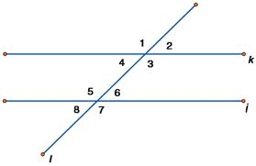
The Big Picture
Parallel Lines: j and k
Transversal: l

Slide 3
Corresponding Angles
“Corresponding” means “matching”, so corresponding angles are the ones at the same location at each intersection.
Which pairs of angles are corresponding? (List!)

Slide 4
Alternate Interior Angles
To “alternate” means to switch back and forth (across the transversal)
“Interior” means “inside” (the parallel lines).
Which pairs of angles are alternate interior?

Slide 5
Alternate Exterior Angles
To “alternate” means to switch back and forth (across the transversal)
“Exterior” means “outside” (the parallel lines).
Which pairs of angles are alternate exterior?

Slide 6
Same Side Interior Angles
“Same side” means to be on the same side (of the transversal) (sort of obvious!)
“Interior” means “inside” (the parallel lines).
Which pairs of angles are same side interior?

