Slide 1
Chapter 7 Exponential and Logarithmic Functions
Unit Essential Questions:
How do you model a quantity that changes regularly over time by the same percentage?
How are exponents and logarithms related?
How are exponential functions and logarithmic functions related?

Slide 2
Section 7.1 Exploring Exponential Models
Students will be able to model exponential growth and decay

Slide 3
Warm Up
Evaluate each expression for the given value of x.
2^{x} for x = 3
2³ = 2 • 2 • 2 = 8
2. 2^{3x+4} for x = –1
2^{3(–1)+4} = 2^{–3+4} = 2¹ = 2
3. (1/2)^{x} for x = 0
(1/2)⁰ = 1

Slide 4
Key Concepts
Exponential function - a function with the general form y=ab^{x}, where x is a real number, a ≠ 0, b > 0, and b ≠ 0.
Growth factor - when b > 1
Decay factor - when 0 < b < 1
Asymptote- a line that a graph approaches as x or y increases in absolute value.

Slide 5
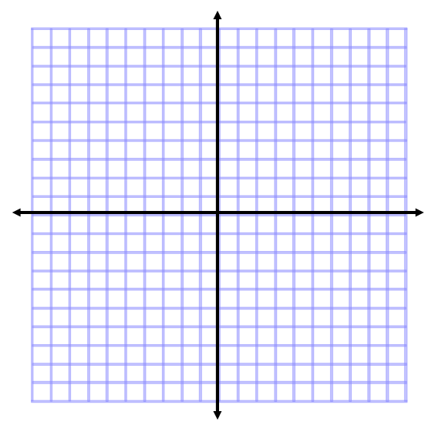
Example 1
Graph y = 3^{x}.
Step 1: Make a table of values.
x 3^{x} y
–3 3⁻³ 1/27
–2 3⁻² 1/9
–1 3⁻¹ 1/3
0 3⁰ 1
1 3¹ 3
2 3² 9
3 3³ 27

Slide 6
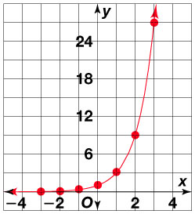
Example 1 (Continued)
Graph y = 3^{x}.
Step 2: Graph the coordinates.
Connect the points with a smooth curve.

Slide 7
Example 2
Without graphing, determine whether the function y = 3 (2/3)^{x} represents exponential growth or decay.
In y = 3 (2/3)^{x} , b = 2/3.
Since 0 < b < 1, the function represents exponential decay.

Slide 8
Example 3
Graph y = 6(0.5)^{x}. Identify the horizontal asymptote.
Step 1: Make a table of values.
x | y
-3 | 48
-2 | 24
-1 | 12
0 | 6
1 | 3
2 | 1.5
3 | .75

Slide 9
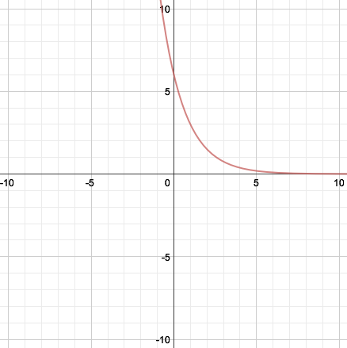
Example 3 (Continued)
Graph y = 6(0.5)^{x}. Identify the horizontal asymptote.
Step 2: Graph the coordinates. Connect the points with a smooth curve.
As x increases, y approaches 0.
The horizontal asymptote is the x-axis, y = 0.

Slide 10
Key Concepts
When a real-life quantity increases by a fixed percent each time period, the amount A of the quantity after t time periods (usually years) can be modeled by the equation
A = P(1 + r)^{t}
Where A is the final amount, P is the principal (initial amount) and r is the percent increase/decrease as a decimal. The amount (1 + r) is called the growth/decay factor.

Slide 11
Example 4
You invested $1000 in a savings account at the end of 6th grade. The account pays 5% annual interest. How much money will be in the account after 6 years?
A = a(1 + r)^{t}
A = 1000 (1 + 0.05)⁶ = 1000 (1.05)⁶
≈ $1340.10

Slide 12
Section 7.2 Part 1 Properties of Exponential Functions
Students will be able to explore functions in the form y = ab^{x}

Slide 13
Warm Up
Write an equation for each translation.
y = | x |, 1 unit up, 2 units left
y = | x + 2 | + 1
y = x², 2 units down, 1 unit right
y = (x – 1)² – 2

Slide 14
Key Concepts
Transformations of y = ab^{x-h} + k
Vertical Translation (k units) Up: y = b^{x} + k Down: y = b^{x} - k | Horizontal Translation (h units) Right: y = b^{x – h} Left: y = b^{x + h}
Vertical Stretch/Compression Stretch (a>1): y = ab^{x} Compression (0<a<1): y = ab^{x} | Reflection x-axis: y = -b^{x}
*Remember – If the graph shifts up or down, so does the horizontal asymptote!

Slide 15
Example 1
Graph y = 3 (2)^{x} and y = –3 (2)^{x}. Label the asymptote of each graph.
Step 1: Make a table of values
x | y = 3 (2)^{x} | y = - 3 (2)^{x}
-3 | 3/8 | -3/8
-2 | 3/4 | -3/4
-1 | 3/2 | -3/2
0 | 3 | -3
1 | 6 | -6
2 | 12 | -12
3 | 24 | -24

Slide 16
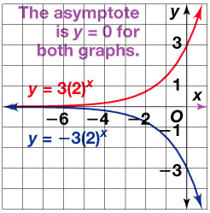
Example 1 (Continued)
Graph y = 3 (2)^{x} and y = –3 (2)^{x}. Label the asymptote of each graph.
Step 2: Graph each function.

Slide 17
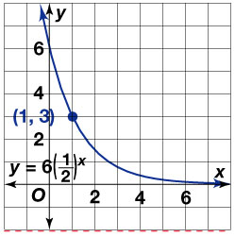
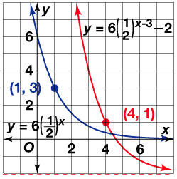
Example 2
Graph y = 6 (1/2)^{x} and y = 6 (1/2)^{x - 3} – 2.
Step 1: Graph y = 6 (1/2)^{x}. The horizontal asymptote is y = 0.
Step 2: For y = 6 (1/2)^{x - 3} – 2, h = 3 and k = -2.
So shift the graph of the present function 3 units right and 2 units down.
The horizontal asymptote is y = –2.

Slide 18
Section 7.2 Part 2 Properties of Exponential Functions
Students will be able to graph exponential functions with base e

Slide 19
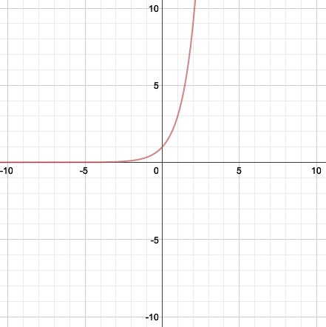
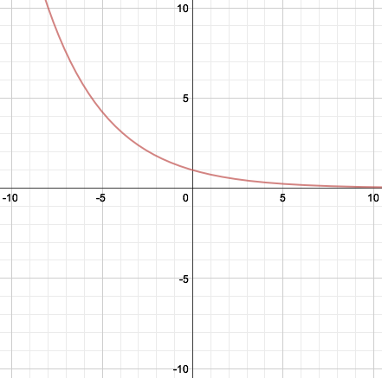
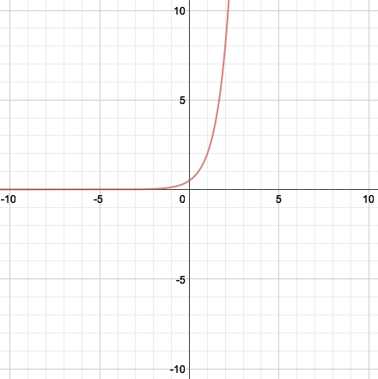
Warm Up
Graph each function.
1. y = 3^{x} 2. y = 0.75^{x} 3. y = 0.5 (4)^{x}

Slide 20
Key Concepts
e - an irrational number approximately equal to 2.71828
e is useful for describing continuous growth or decay.

Slide 21
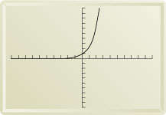
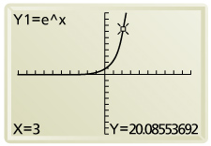
Example 1
Graph y = e^{x}. Evaluate e³ to four decimal places.
Step 1: Graph y = e^{x}.
Step 2: Find y when x = 3.
The value of e³ is about 20.0855.

Slide 22
Key Concepts
Continuously Compounded Interest Formula
A = Pe^{rt}
A = amount in account
P = principal
r = annual rate or interest
t = time in years

Slide 23
Example 2
Suppose you invest $100 at an annual interest rate of 4.8% compounded continuously. How much will you have in the account after 3 years?
A = Pe^{rt}
= 100 e^{0.048(3)} Substitute 100 for P, 0.048 for r, and 3 for t
= 100 e^{0.144} Simplify
= 100 (1.154884) Evaluate e^{0.144}
≈115.49 Simplify
You will have about $115.49 in the account after three years.

Slide 24
Section 7.3 Logarithmic Functions as Inverses
Students will be able to write and evaluate logarithmic expressions
Students will be able to graph logarithmic functions

Slide 25
Warm Up
Solve each equation.
8 = x³
2
x^{1/4} = 2
16
27 = 3^{x}
3
4⁶ = 4^{3x}
2

Slide 26
Key Concepts
Logarithm- has base b of a positive number y is defined as follows:
If y = b^{x}, then logb y = x.
Common logarithm- a logarithm that uses base 10. ex. log 8

Slide 27
Example 1
Write in logarithmic form.

Slide 28
Example 2
Write in exponential form.

Slide 29
Example 3
Evaluate log₃ 81.
Let log₃ 81 = x.
log₃ 81 = x Write in logarithmic form.
81 = 3^{x} Convert to exponential form.
3⁴ = 3^{x} Write each side using base 3.
4 = x Set the exponents equal.
So log₃ 81 = 4.

Slide 30
Example 4
Evaluate
Let log₈ 2 = x.
log₈ 2 = x Write in logarithmic form.
2 = 8^{x} Convert to exponential form.
2¹ = 2^{3x} Write each side using base 3.
1 = 3x Set the exponents equal.
So log₃ 81 = 1/3.

Slide 31
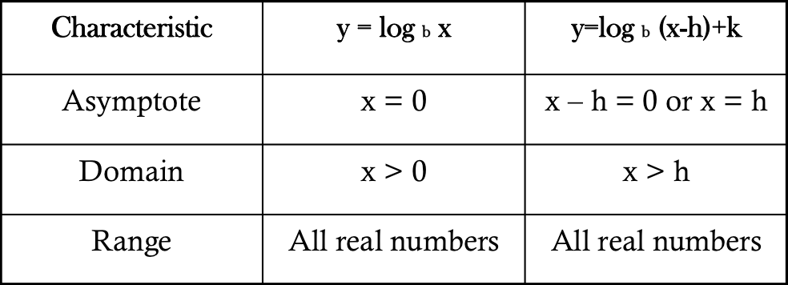
Key Concepts
Logarithmic function- the inverse of an exponential function.

Slide 32
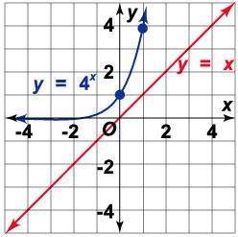
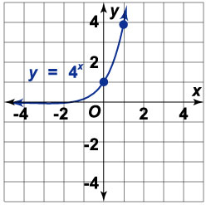
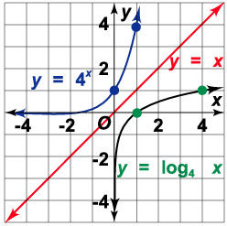
Example 5
Graph y = log₄ x.
By definition of logarithm, y = log₄ x is the inverse of y = 4^{x}.
Step 1: Graph y = 4^{x}
Step 2: Draw y = x.
Step 3: Choose a few points on 4^{x}. Reverse the coordinates and plot the points of y = log₄ x.

Slide 33
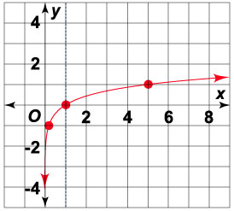
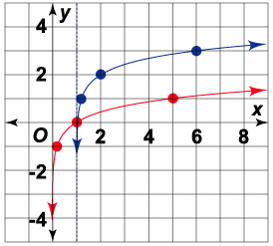
Example 6
Graph y = log₅ (x – 1) + 2.
Step 1: Graph y = log₅ x
Step 2: Graph the function by shifting the points from the graph to the right 1 unit and up 2 units.

Slide 34
Section 7.4 Properties of Logarithms
Students will be able to use properties of logarithms

Slide 35
Warm Up
Evaluate each expression for x = 3.
x³ – x
24
x⁵ x²
2187
x³ + x²
36

Slide 36
Key Concepts
Properties of Logarithms
log_{b}MN = log_{b}M + log_{b}N Product Property
log_{b}M/N = log_{b}M – log_{b}N Quotient Property
log_{b}M^{n} = nlog_{b}M Power Property

Slide 37
Example 1
Write each logarithmic expression as a single logarithm.
log₄ 64 – log₄ 16
= log₄(64/16) Quotient Property
= log₄ 4 Simplify
= 1 Simplify
6 log₅ x + log₅ y
= log₅ x⁶ + log₅ y Power Property
= log₅ (x⁶y) Product Property

Slide 38
Example 2
Expand each logarithm.
log₇ (t/u)
log₇ t – log₇ u Quotient Property
log(4p³)
= log 4 + log p³ Product Property
= log 4 + 3 log p Power Property

Slide 39
Key Concepts
Change of Base Formula
log_{b} M = log_{c} M/log_{c}b
Your calculator finds log₁₀ of a number. To evaluate a logarithm with any base, use the change of base formula.
log_{b} M = log₁₀ M/log₁₀ b
or simply, log_{b} M = log M/log b

Slide 40
Example 3
Use the Change of Base Formula to evaluate log₆12.
log₆12 = (log 12) / (log 6)
≈1.387

Slide 41
Section 7.5 Exponential and Logarithmic Equations
Students will be able to solve exponential equations
Students will be able to solve logarithmic equations

Slide 42
Warm Up
Write each expression as a single logarithm. State the property you used.
log 12 – log 3 2. 3 log₁₁5 + log₁₁7
Expand each logarithm.
3. log_{c}(a/b) 4. log₃x⁴
log 4; Quotient Property
log₁₁(5³ • 7); Power Property and Product Property
log_{c}a – log_{c}b
4 log₃x

Slide 43
Key Concepts
Exponential Equation - an equation of the form b^{cx} = a, where the exponent includes a variable.
Steps to solving exponential equations
Isolate the exponential expression
Take the logarithm of each side.
Use the Power Property of Logarithms
Solve

Slide 44
Example 1
Solve 5^{2x} = 16.
5^{2x} = 16 Isolate the exponential expression
log 5^{2x} = log 16 Take the common logarithm of each side.
2x log 5 = log 16 Use the power property of logarithms.
log 16
2 log 5
x = Divide each side by 2 log 5.
≈ 0.8614 Use a calculator.

Slide 45
Example 2
Solve 7 – 5^{2x – 1} = 4.
- 5^{2x – 1} = -3 Isolate the exponential expression
5^{2x – 1} = 3 Multiply each side by -1.
log 5^{2x - 1} = log 3 Take the common logarithm of each side.
(2x – 1) log 5 = log 3 Use the power property of logarithms.
Divide each side by log 5.
Add 1 to each side.
x ≈ 0.8413 Divide by 2.

Slide 46
Key Concepts
Logarithmic Equation - an equation that includes a logarithmic expression.
Steps to solving logarithmic equations
Write as a single logarithm
Write in exponential form
Solve

Slide 47
Example 3
Solve log (2x – 2) = 4.
log (2x – 2) = 4 Write as a single logarithm
2x – 2 = 10⁴ Write in exponential form.
2x – 2 = 10000
x = 5001 Solve for x.

Slide 48
Example 4
Solve 3 log x – log 2 = 5.
x³
2
log ( ) = 5 Write as a single logarithm.
x³
2
= 10⁵ Write in exponential form.
x³ = 2(100,000) Multiply each side by 2.
x ≈ 58.48 Cube root both sides

