Slide 1
Chapter 6 Radical Functions and Rational Exponents
Unit Essential Questions:
To simplify the nth root of an expression, what must be true about the expression?
When you square each side of an equation, is the resulting equation equivalent to the original?
How are functions and its inverse related?

Slide 2
Lesson 6.0 Properties of Exponents
Students will be able to simplify expressions using properties of rational exponents

Slide 3
Warm Up
Write each number as a square of a number.
25 2. 0.09
5² 0.3²
Write each expression as a square of an expression.
3. x¹⁰ 4. 169x⁶y¹²
(x⁵)² (13x³y⁶)²

Slide 4
Key Concepts
Properties of Exponents
Assume that no denominator is equal to zero and m and n are integers

Slide 5
Example 1
Simplify and rewrite each expression using only positive exponents.
b.

Slide 6
Example 2
Simplify and rewrite each expression using only positive exponents.
a. b.

Slide 7
Example 3
Simplify and rewrite each expression using only positive exponents.
a. b.

Slide 8
Lesson 6.1 Roots and Radical Expressions
Students will be able to find nth roots

Slide 9
Warm Up
Simplify.
1. 2. 3.

Slide 10
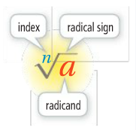
Key Concepts
nth Root - For any real numbers a and b, and any positive integer n, if
a^{n} = b, then a is an nth root of b.
If n is odd, there is 1 real nth root.
If n is even, there are 2 real nth roots.
Radicand - the number under the radical.
Index - the degree of the root.
Principal Root - the positive root when the number has two real roots.

Slide 11
Example 1
Find all the real cube roots of:
0.027
-125
1/64

Slide 12
Example 2
Find all the fourth roots of:
625
-0.0016
81/625
There is no real number with a fourth power of -0.0016

Slide 13
Example 3
What is each principal real-number root?
There is no real number with a
fourth power of -16

Slide 14
Key Concepts
nth Roots of nth Powers
For any real number a,

Slide 15
Example 3
Simplify each radical expression.
a. b.

Slide 16
Lesson 6.2 Part 1 Multiplying Radical Expressions
Students will be able to multiply radical expressions

Slide 17
Warm Up
Find each missing factor.
150 = 5²( ) 2. 54 = ( )³(2)
48 = 4²( ) 4. x⁵ = ( )²(x)
5. 3a³b⁴ = ( )³(3b) 6. 75a⁷b⁸ = ( )²(3a)
6
3
3
x²
ab
5a³b⁴

Slide 18
Key Concepts
Combining Radical Expressions: Product
Simplest Form – where the radicand of has a perfect nth power among its factors that can be reduced to a simpler form as much as possible.

Slide 19
Example 1
Can you simplify the product of the rational expressions? Explain.
a.
b.
c.
No, Indexes are different

Slide 20
Example 2
Simplify .
Find all perfect square factors
Simplify
Reorder

Slide 21
Example 3
Multiply and Simplify .
Combine like terms
Multiply
Find all perfect cube factors
Simplify
Reorder

Slide 22
Lesson 6.2 Part 2 Dividing Radical Expressions
Students will be able to divide radical expressions

Slide 23
Warm Up
Simplify.
2.

Slide 24
Key Concepts
Combining Radical Expressions: Quotient
Rationalize the Denominator – rewriting an expression so that there are no radicals in the denominator and no fractions in any radical expression.

Slide 25
Example 1
Divide and simplify.
a. b.

Slide 26
Example 2
Simplify

Slide 27
Example 3
Simplify

Slide 28
Lesson 6.3 Binomial Radical Expressions
Students will be able to add and subtract radical expressions

Slide 29
Warm Up
Multiply.
(5x + 4)(3x – 2)
15x² - 10x + 12x - 8
15x² + 2x – 8
(x + 5)²
x² + 5x + 5x + 25
x² + 10x + 25

Slide 30
Key Concepts
Like Radicals - radical expressions that have the same index and the same radicand.
Rationalizing the Denominator of a Binomial - multiply the numerator and denominator of the fraction by the conjugate of the denominator.

Slide 31
Example 1
Add or Subtract, if possible.
a.
b.
Have different radicands, cannot subtract

Slide 32
Example 2
Simplify

Slide 33
Example 3
Multiply

Slide 34
Example 4
Rationalize the denominator

Slide 35
Lesson 6.4 Part 1 Rational Exponents
Students will be able to use rational exponents

Slide 36
Warm Up
Simplify.
2^{–4} 2. (3x)^{–2}
(5x²y)^{–3} 4. (2a^{–2}b³)⁴

Slide 37
Key Concepts
Rational Exponent
If the nth root of a is a real number, m is an integer and m/n is in lowest terms, then

Slide 38
Example 1
Simplify.
a. b. c.

Slide 39
Example 2
Convert to radical form.
a. b.

Slide 40
Example 3
Convert to exponential form.
a. b.

Slide 41
Lesson 6.4 Part 2 Rational Exponents
Students will be able to use rational exponents

Slide 42
Warm Up
Simplify.
(x²)³
x⁶
(pq)⁵
p⁵q⁵
(2⁴)(2⁵)
2⁹ = 512

Slide 43
Key Concepts
All the properties of integer exponents also apply to rational exponents.
Properties of Exponents
Assume that no denominator is equal to zero

Slide 44
Example 1
Write in simplest form.

Slide 45
Example 2
Simplify each number.
a. b. 25^{-2.5}

Slide 46
Example 3
Write in simplest form.

Slide 47
Lesson 6.5 Part 1 Solving Square Root and Other Radical Equations
Students will be able to solve square root and other radical equations

Slide 48
Warm Up
Solve by factoring.
x² + x - 6= 0
x = 2, -3
x² = 5x + 14
x = 7, -2

Slide 49
Key Concepts
Radical Equation - an equation that has a variable in a radicand or has a variable with a rational exponent.
Steps to Solve a Radical Equation
1. Isolate the radical.
2. Raise each side of the equation to a power equal to the index of the radical.
3. Solve the resulting equation. If the equation still has a radical then repeat steps 1 and 2.
4. Check your answer.

Slide 50
Example 1

Slide 51
Key Concepts
Steps to Solve an Equation with a Rational Exponent
1. Isolate the expression with the rational exponent.
2. Raise each side of the equation to the reciprocal of the rational exponent.
If the numerator or denominator are even,
If the numerator and denominator are odd,
3. Solve the resulting equation.
4. Check your answer.

Slide 52
Example 2
Solve

Slide 53
Example 3
Solve

Slide 54
Lesson 6.5 Part 2 Solving Square Root and Other Radical Equations
Students will be able to solve square root and other radical equations with extraneous solutions

Slide 55
Warm Up
Solve |3x + 2| - 5 = 4x. Check for extraneous solutions.
|3x + 2| = 4x + 5
3x + 2 = 4x + 5 or 3x + 2 = -(4x + 5)
x = -3 or 3x + 2 = -4x - 5
x = -1
✖
✔

Slide 56
Key Concepts
Note: It is possible to get extraneous solutions for square root and other radical equations. Therefore, you must check all solutions.

Slide 57
Example 1
Isolate the radical
Square both sides
Simplify
Combine like terms
Factor
Factor Theorem

Slide 58
Example 1 (Continued)
Check solutions
✔
The only solution is –1.

Slide 59
Example 2
Isolate the radical
Square both sides
Simplify
Combine like terms
Square both sides
Simplify

Slide 60
Example 2 (Continued)
Put quadratic in standard form
Factor
Factor Theorem
Solve
Check
✔
✔

Slide 61
Lesson 6.6 Function Operations
Students will be able to add, subtract, multiply, and divide functions
Students will be able to find the composite of two functions

Slide 62
Warm Up
Perform the indicated operation.
(x + 2x² – 4) + (x² – 3x + 9)
3x² – 2x +5
(x + 3)(x² – 2)
x³ + 3x² - 2x - 6
(x – 1) – (5 + x)
-6

Slide 63
Key Concepts
Function Operations
Addition (f + g)(x) = f(x) + g(x)
Multiplication (f • g)(x) = f(x) • g(x)
Subtraction (f – g)(x) = f(x) – g(x)
Division (f/g)(x) = f(x)/g(x), g(x) ≠ 0

Slide 64
Example 1
Let f (x) = –2x + 6 and g (x) = 5x – 7.
Find (f + g)(x) and (ƒ – g)(x) and their domains.
The domain of f is the set of all real numbers.
The domain of g is the set of all real number.
The domain of both f + g and f – g is the set all numbers common
to the domain both f and g, which is all real numbers.

Slide 65
Example 2
Let f(x) = x² + 1 and g(x) = x⁴ – 1. Find f • g and f/g and their domains.
The domains of f and g are the set of real numbers, so the domain of f • g is also the set of real numbers.
The domain of f/g does not include 1 and –1 because g(1) and g(–1) = 0.
So the domain of f/g is all real numbers except 1 and -1.

Slide 66
Key Concepts
Composite Function
The composition of function g with function f is written as and is defined as , where the domain of consists of the values in the domain of f such that f (a) is in the domain of g.
To Evaluate:
Read right to left.
Evaluate the inner function f(x) first.
Then use your answer as the input of the outer function g(x).

Slide 67
Example 3
Let ƒ(x) = x³ and g(x) = x² + 7. Find (g ° ƒ)(2).
Method 1:
Method 2:
(g ° ƒ)(x) = g(ƒ(x)) = g(x³) = x⁶ + 7
(g ° ƒ)(x) = g(ƒ(x))
(g ° ƒ)(2) = (2)⁶ + 7 = 64 + 7 = 71
g(ƒ(2)) = g(2³)
= g(8)
= 8² + 7
= 71

Slide 68
Example 4
A store offers a 20% discount on all items. You have a coupon worth $3.
a. Use functions to model discounting an item by 20% and to model applying the coupon.
Let x = the original price.
ƒ(x) = x – 0.2x = 0.8x Cost with 20% discount.
g(x) = x – 3 Cost with a coupon for $3.
b. Use a composition of your two functions to model how much you would pay for an item if the clerk applies the discount first and then the coupon.
(g ° ƒ)(x) = g(ƒ(x)) Applying the discount first.
= g(0.8x)
= 0.8x – 3

Slide 69
Example 4 (Continued)
c. Use a composition of your two functions to model how much you would pay for an item if the clerk applies the coupon first and then the discount.
(ƒ ° g)(x) = ƒ(g(x)) Applying the coupon first.
= ƒ(x – 3)
= 0.8(x – 3)
= 0.8x – 2.4
d. How much more is any item if the clerk applies the coupon first?
(ƒ ° g)(x) – (g ° ƒ)(x) = (0.8x – 2.4) – (0.8x – 3)
= 0.6
Any item will cost $.60 more.

Slide 70
Lesson 6.7 Part 1 Inverse Relations and Functions
Students will be able to find the inverse of a relation or function

Slide 71
Warm Up
Solve for y.
x = 2y – 6 2. x = 2y² + 5

Slide 72
Key Concepts
Inverse relation - “undoes” the relation and maps b back to a.
Inverse Functions - if you have f as a function then f ⁻¹ is its inverse.

Slide 73
Example 1
Find the inverse of relation m.
Relation m
x –1 0 1 2
y –2 –1 –1 –2
Interchange the x and y columns.
Inverse of Relation m
x –2 –1 –1 –2
y –1 0 1 2

Slide 74
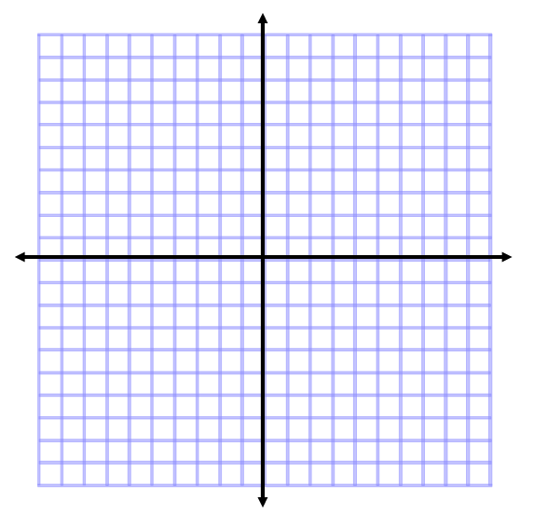
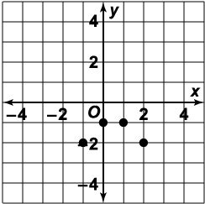
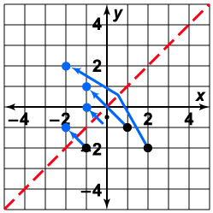
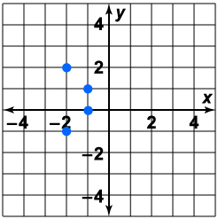
Example 2
What is the graph of the inverse of graph m?
Reversing the Ordered Pairs
Relation m
Inverse of m

Slide 75
Example 3
Find the inverse of y = x² – 2.
Switch x and y x = y² – 2
Add 2 to each side x + 2 = y²
Square root each side

Slide 76
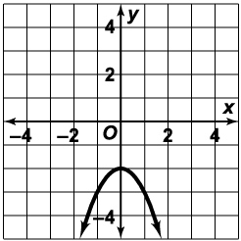
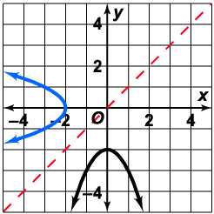
Example 4
Graph y = –x² – 2 and its inverse.
The graph of y = –x² – 2 is a parabola that opens downward with vertex (0, –2).
The reflection of the parabola in the line x = y is the graph of the inverse.
You can also find points on the graph of the inverse by reversing the coordinates of points on y = –x² – 2.

Slide 77
Lesson 6.7 Part 2 Inverse Relations and Functions
Students will be able to find the inverse of a relation or function

Slide 78
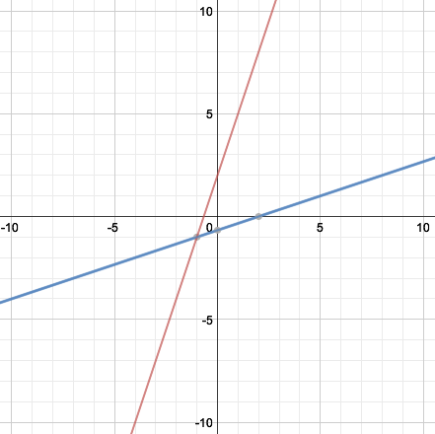
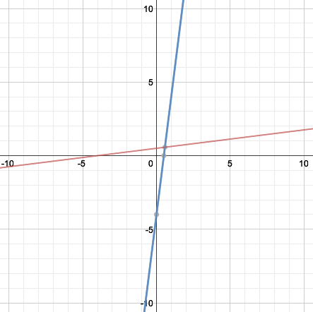
Warm Up
Graph on the same coordinate plane.

Slide 79
Example 1
Consider the function .
a. Find the domain and range of ƒ.
Since the radicand cannot be negative, the domain is the set of numbers greater than or equal to –1.
Since the principal square root is nonnegative, the range is the set of nonnegative numbers.
b. Find ƒ ^{–1}
Rewrite the equation using y.
Interchange x and y.
Square both sides.
Solve for y.

Slide 80
Example 1 (Continued)
c. Find the domain and range of ƒ ^{–1}.
The domain of ƒ ^{–1} equals the range of ƒ, which is the set of nonnegative numbers.
Since x² ≥ 0, . . Thus the range of ƒ ^{–1} is the set of numbers greater than or equal to –1.
Note that the range of ƒ ^{–1} is the same as the domain of ƒ.
d. Is ƒ ^{–1} a function? Explain.
For each x in the domain of ƒ ^{–1}, there is only one value of ƒ ^{–1}(x). So ƒ ^{–1} is a function.

Slide 81
Key Concepts
Composition of Inverse Functions
If f and f⁻¹ are inverse functions, then

Slide 82
Example 2
For the function ƒ(x) = ½x + 5, find (ƒ ^{–1} ° ƒ)(652) and .
Since ƒ is a linear function, so is ƒ ^{–1}.
Therefore ƒ ^{–1} is a function.
So (ƒ ^{–1} ° ƒ )(652) = 652

Slide 83
Lesson 6.8 Graphing Radical Functions
Students will be able to graph square root and other radical functions

Slide 84
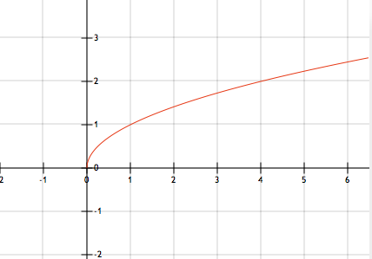
Warm Up
Using a table, graph .
x | y
0 | 0
1 | 1
4 | 2
9 | 3

Slide 85
Key Concepts
Transformations of y = a + k
Vertical Translation (k units) Up: y = + k Down: y = - k | Horizontal Translation (h units) Right: y = Left: y =
Vertical Stretch/Compression Stretch (a>1): y = a Compression (0<a<1): y = a | Reflection x-axis: y = -

Slide 86
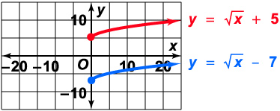
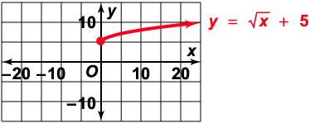
Example 1
Graph .
The graph of is the graph of shifted up 5 units.
The graph is the graph of shifted down 7 units.
The domains of both functions are the set of nonnegative numbers, but their ranges differ.

Slide 87
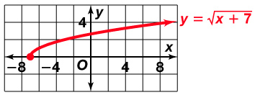
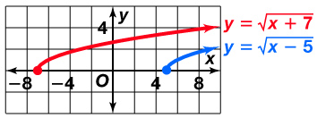
Example 2
Graph .
The graph of is the graph of shifted left 7 units.
The graph is the graph of
shifted right 5 units.
The ranges of both functions are the set of nonnegative numbers, but their domains differ.

Slide 88
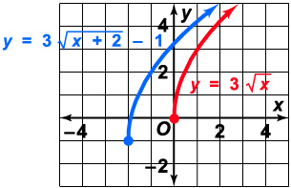
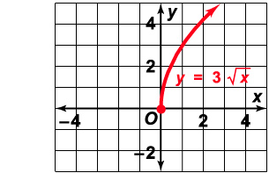
Example 3
Graph .
so translate the graph of left 2 units and down 1 unit.

Slide 89
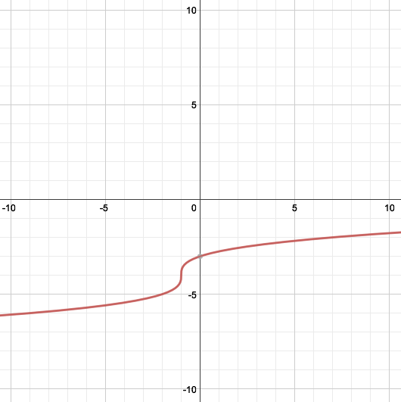
Example 4
What is the graph of .
Step 1: Graph
Step 2: Shift graph left 1
unit and down 4 units

