Slide 1
Parallel Lines, Transversals & Angles
Bellwork

Slide 2
10 minutes!

Slide 3
9 minutes!

Slide 4
8 minutes!

Slide 5
7 minutes!

Slide 6
6 minutes!

Slide 7
5 minutes!

Slide 8
4 minutes!

Slide 9
3 minutes!

Slide 10
2 minutes!

Slide 11
1 minute!

Slide 12
STOP!

Slide 13
STOP!

Slide 14
STOP!

Slide 15
Nov. 17
Define parallel lines.
What is a transversal?
Must two lines be parallel to be cut by a transversal?

Slide 16
Nov. 18
Copy & complete:
How can you determine which angles are corresponding angles?
What is another name for consecutive angles? What is special about them?
Alternate interior and alternate exterior angles lie on ____________________ of the transversal and are _____________.

Slide 17
Bellwork – 10 minutes!
Find the value of x:
(2x+20)°
3x°

Slide 18
Bellwork – 9 minutes!
Find the value of x:
(2x+20)°
3x°

Slide 19
Bellwork – 8 minutes!
Find the value of x:
(2x+20)°
3x°

Slide 20
Bellwork – 7 minutes!
Find the value of x:
(2x+20)°
3x°

Slide 21
Bellwork – 6 minutes!
Find the value of x:
(2x+20)°
3x°

Slide 22
Bellwork – 5 minutes!
Find the value of x:
(2x+20)°
3x°

Slide 23
Bellwork – 4 minutes!
Find the value of x:
(2x+20)°
3x°

Slide 24
Bellwork – 3 minutes!
Find the value of x:
(2x+20)°
3x°

Slide 25
Bellwork – 2 minutes!
Find the value of x:
(2x+20)°
3x°

Slide 26
Bellwork – 1 minute!
Find the value of x:
(2x+20)°
3x°

Slide 27
Bellwork – STOP!
Find the value of x:
(2x+20)°
3x°

Slide 28
Today you will work to begin tiered activities. You must advance groups to get the highest possible grade.
Group A (highest grade 76) – Identify angle relationships.
Group B (highest grade 88) – Describe angle relationships and find measures of angles.
Group C (highest grade 100) - Identify angles and relationships, write and solve equations for situations involving variables.

Slide 29
Bellwork – 10 minutes!
Find the value of x and the measure of the angle:
81°
(7x+15)°

Slide 30
Bellwork – 9 minutes!
Find the value of x and the measure of the angle:
81°
(7x+15)°

Slide 31
Bellwork – 8 minutes!
Find the value of x and the measure of the angle:
81°
(7x+15)°

Slide 32
Bellwork – 7 minutes!
Find the value of x and the measure of the angle:
81°
(7x+15)°

Slide 33
Bellwork – 6 minutes!
Find the value of x and the measure of the angle:
81°
(7x+15)°

Slide 34
Bellwork – 5 minutes!
Find the value of x and the measure of the angle:
81°
(7x+15)°

Slide 35
Bellwork – 4 minutes!
Find the value of x and the measure of the angle:
81°
(7x+15)°

Slide 36
Bellwork – 3 minutes!
Find the value of x and the measure of the angle:
81°
(7x+15)°

Slide 37
Bellwork – 2 minutes!
Find the value of x and the measure of the angle:
81°
(7x+15)°

Slide 38
Bellwork – 1 minute!
Find the value of x and the measure of the angle:
81°
(7x+15)°

Slide 39
Bellwork – STOP! TURN IN ALL BOOKS NOW OR NOT AT ALL!!
Find the value of x and the measure of the angle:
81°
(7x+15)°

Slide 40
Bellwork – STOP! TURN IN ALL BOOKS NOW OR NOT AT ALL!!
Find the value of x and the measure of the angle:
81°
(7x+15)°

Slide 41
Bellwork – STOP! TURN IN ALL BOOKS NOW OR NOT AT ALL!!
Find the value of x and the measure of the angle:
81°
(7x+15)°

Slide 42
Bellwork – STOP! TURN IN ALL BOOKS NOW OR NOT AT ALL!!
Find the value of x and the measure of the angle:
81°
(7x+15)°

Slide 43
Bellwork – STOP! TURN IN ALL BOOKS NOW OR NOT AT ALL!!
Find the value of x and the measure of the angle:
81°
(7x+15)°

Slide 44
Today you will work to begin tiered activities. You must advance groups to get the highest possible grade.
Group A (highest grade 76) – Identify angle relationships.
Group B (highest grade 88) – Describe angle relationships and find measures of angles.
Group C (highest grade 100) - Identify angles and relationships, write and solve equations for situations involving variables.

Slide 45
Bellwork – 10 minutes!
Find the values of x and y. Then find the measure of each labeled angle.
2x° 3y °
(x-12) ° (y+20) °

Slide 46
Bellwork – 9 minutes!
Find the values of x and y. Then find the measure of each labeled angle.
2x° 3y °
(x-12) ° (y+20) °

Slide 47
Bellwork – 8 minutes!
Find the values of x and y. Then find the measure of each labeled angle.
2x° 3y °
(x-12) ° (y+20) °

Slide 48
Bellwork – 7 minutes!
Find the values of x and y. Then find the measure of each labeled angle.
2x° 3y °
(x-12) ° (y+20) °

Slide 49
Bellwork – 6 minutes!
Find the values of x and y. Then find the measure of each labeled angle.
2x° 3y °
(x-12) ° (y+20) °

Slide 50
Bellwork – 5 minutes!
Find the values of x and y. Then find the measure of each labeled angle.
2x° 3y °
(x-12) ° (y+20) °

Slide 51
Bellwork – 4 minutes!
Find the values of x and y. Then find the measure of each labeled angle.
2x° 3y °
(x-12) ° (y+20) °

Slide 52
Bellwork – 3 minutes!
Find the values of x and y. Then find the measure of each labeled angle.
2x° 3y °
(x-12) ° (y+20) °

Slide 53
Bellwork – 2 minutes!
Find the values of x and y. Then find the measure of each labeled angle.
2x° 3y °
(x-12) ° (y+20) °

Slide 54
Bellwork – 1 minute!
Find the values of x and y. Then find the measure of each labeled angle.
2x° 3y °
(x-12) ° (y+20) °

Slide 55
Bellwork – STOP!
Find the values of x and y. Then find the measure of each labeled angle.
2x° 3y °
(x-12) ° (y+20) °

Slide 56
Bellwork – STOP!
Find the values of x and y. Then find the measure of each labeled angle.
2x° 3y °
(x-12) ° (y+20) °

Slide 57
Bellwork – STOP!
Find the values of x and y. Then find the measure of each labeled angle.
2x° 3y °
(x-12) ° (y+20) °

Slide 58
Bellwork – STOP!
Find the values of x and y. Then find the measure of each labeled angle.
2x° 3y °
(x-12) ° (y+20) °

Slide 59
Bellwork – STOP!
Find the values of x and y. Then find the measure of each labeled angle.
2x° 3y °
(x-12) ° (y+20) °

Slide 60
Today you will work to finish tiered activities. Your final grade will be determined based on the group you finish at the end of today.
Group A (highest grade 76) – Identify angle relationships.
Group B (highest grade 88) – Describe angle relationships and find measures of angles.
Group C (highest grade 100) - Identify angles and relationships, write and solve equations for situations involving variables.

Slide 61
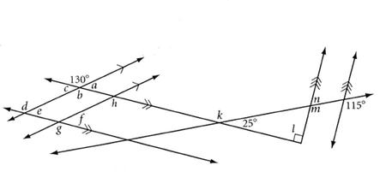
10 minutes!!
Find the measure of each angle, a through m.

Slide 62
9 minutes!!
Find the measure of each angle, a through m.

Slide 63
8 minutes!!
Find the measure of each angle, a through m.

Slide 64
7 minutes!!
Find the measure of each angle, a through m.

Slide 65
6 minutes!!
Find the measure of each angle, a through m.

Slide 66
5 minutes!!
Find the measure of each angle, a through m.

Slide 67
4 minutes!!
Find the measure of each angle, a through m.

Slide 68
3 minutes!!
Find the measure of each angle, a through m.

Slide 69
2 minutes!!
Find the measure of each angle, a through m.

Slide 70
1 minute!!
Find the measure of each angle, a through m.

Slide 71
STOP. TURN IN ALL BOOKS NOW!!
Find the measure of each angle, a through m.

Slide 72
STOP. TURN IN ALL BOOKS NOW!!
Find the measure of each angle, a through m.

Slide 73
STOP. TURN IN ALL BOOKS NOW!!
Find the measure of each angle, a through m.

Slide 74
STOP. TURN IN ALL BOOKS NOW!!
Find the measure of each angle, a through m.

Slide 75
STOP. TURN IN ALL BOOKS NOW!!
Find the measure of each angle, a through m.

Slide 76
Today’s Activities.
Turn in tiered group assignment activity completed for homework.
Create vocabulary study guide aides for upcoming assessment.
Angle Pairs Formed by Parallel Lines Cut by a Transversal – cut the pieces showing various angle pairs and paste them in the proper angle type.
Parallel Lines Angle Pairs Foldable – Define and explain the relationship of the angle pairs created by parallel lines cut by a transversal.
Exit Ticket.

Slide 77
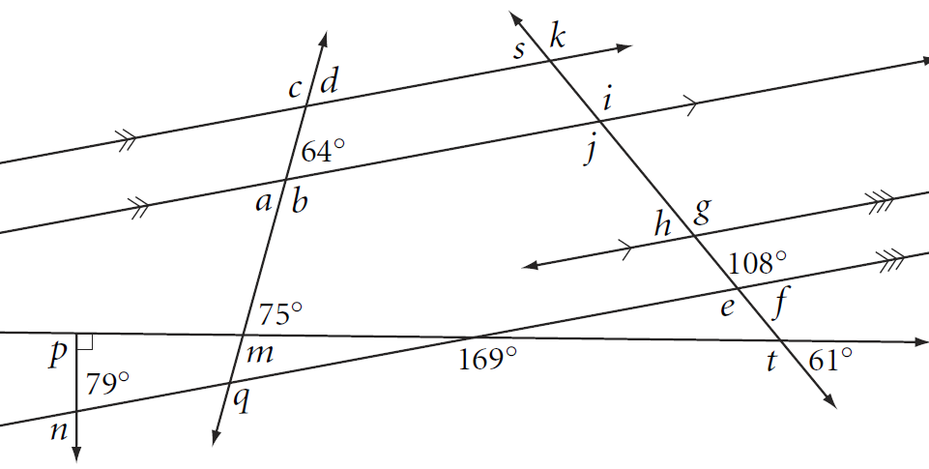
10 minutes
Find the measure of each angle, a through t.

Slide 78
9 minutes
Find the measure of each angle, a through t.

Slide 79
8 minutes
Find the measure of each angle, a through t.

Slide 80
7 minutes
Find the measure of each angle, a through t.

Slide 81
6 minutes
Find the measure of each angle, a through t.

Slide 82
5 minutes
Find the measure of each angle, a through t.

Slide 83
4 minutes
Find the measure of each angle, a through t.

Slide 84
3 minutes
Find the measure of each angle, a through t.

Slide 85
2 minutes
Find the measure of each angle, a through t.

Slide 86
1 minute
Find the measure of each angle, a through t.

Slide 87
STOP. TURN IN ALL BOOKS NOW!!
Find the measure of each angle, a through t.

Slide 88
STOP. TURN IN ALL BOOKS NOW!!
Find the measure of each angle, a through t.

Slide 89
STOP. TURN IN ALL BOOKS NOW!!
Find the measure of each angle, a through t.

Slide 90
STOP. TURN IN ALL BOOKS NOW!!
Find the measure of each angle, a through t.

Slide 91
STOP. TURN IN ALL BOOKS NOW!!
Find the measure of each angle, a through t.

Slide 92
Today’s Activities.
Working with a partner, choose eight questions from the worksheet #s 2 - 10.
Find the unknown (labeled) angle. Give reasons for your solutions and show all work.
Exit Ticket.

Slide 93
10 minutes!!
Bellwork

Slide 94
9 minutes!!
Bellwork

Slide 95
8 minutes!!
Bellwork

Slide 96
7 minutes!!
Bellwork

Slide 97
6 minutes!!
Bellwork

Slide 98
5 minutes!!
Bellwork

Slide 99
4 minutes!!
Bellwork

Slide 100
3 minutes!!
Bellwork

Slide 101
2 minutes!!
Bellwork

Slide 102
1 minute!!
Bellwork

Slide 103
STOP. TURN IN ALL BOOKS NOW!!
Bellwork

Slide 104
STOP. TURN IN ALL BOOKS NOW!!
Bellwork

Slide 105
STOP. TURN IN ALL BOOKS NOW!!
Bellwork

Slide 106
STOP. TURN IN ALL BOOKS NOW!!
Bellwork

Slide 107
STOP. TURN IN ALL BOOKS NOW!!
Bellwork

Slide 108
Today’s Activities.
Turn in tiered group assignment activity completed for homework.
Create vocabulary study guide aides for upcoming assessment.
Angle Pairs Formed by Parallel Lines Cut by a Transversal – cut the pieces showing various angle pairs and paste them in the proper angle type.
Parallel Lines Angle Pairs Foldable – Define and explain the relationship of the angle pairs created by parallel lines cut by a transversal.
Exit Ticket.

Slide 109
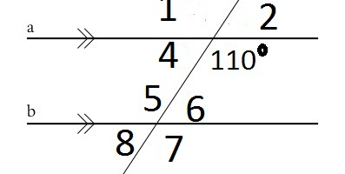
Bellwork – 11 minutes!
Draw the figure and label the angles. Determine the measure of each angle and write it on the figure.

Slide 110
Bellwork – 10 minutes!
Draw the figure and label the angles. Determine the measure of each angle and write it on the figure.

Slide 111
Bellwork – 9 minutes!
Draw the figure and label the angles. Determine the measure of each angle and write it on the figure.

Slide 112
Bellwork – 8 minutes!
Draw the figure and label the angles. Determine the measure of each angle and write it on the figure.

Slide 113
Bellwork – 7 minutes!
Draw the figure and label the angles. Determine the measure of each angle and write it on the figure.

Slide 114
Bellwork – 6 minutes!
Draw the figure and label the angles. Determine the measure of each angle and write it on the figure.

Slide 115
Bellwork – 5 minutes!
Draw the figure and label the angles. Determine the measure of each angle and write it on the figure.

Slide 116
Bellwork – 4 minutes!
Draw the figure and label the angles. Determine the measure of each angle and write it on the figure.

Slide 117
Bellwork – 3 minutes!
Draw the figure and label the angles. Determine the measure of each angle and write it on the figure.

Slide 118
Bellwork – 2 minutes!
Draw the figure and label the angles. Determine the measure of each angle and write it on the figure.

Slide 119
Bellwork – 1 minute!
Draw the figure and label the angles. Determine the measure of each angle and write it on the figure.

Slide 120
Bellwork – STOP. TURN IN ALL BOOKS NOW!
Draw the figure and label the angles. Determine the measure of each angle and write it on the figure.

Slide 121
Bellwork – STOP. TURN IN ALL BOOKS NOW!
Draw the figure and label the angles. Determine the measure of each angle and write it on the figure.

Slide 122
Bellwork – STOP. TURN IN ALL BOOKS NOW!
Draw the figure and label the angles. Determine the measure of each angle and write it on the figure.

Slide 123
Bellwork – STOP. TURN IN ALL BOOKS NOW!
Draw the figure and label the angles. Determine the measure of each angle and write it on the figure.

Slide 124
Bellwork – STOP. TURN IN ALL BOOKS NOW!
Draw the figure and label the angles. Determine the measure of each angle and write it on the figure.

Slide 125
Bellwork – 10 minutes!!
Without using vertical angles, how can you determine the measure of angle e?

Slide 126
Bellwork – 5 minutes!!
Without using vertical angles, how can you determine the measure of angle e?

Slide 127
Bellwork – STOP! TURN IN ALL BOOKS NOW!!
Without using vertical angles, how can you determine the measure of angle e?

Slide 128
Today’s Activities
Pre-assessment on triangles!
Take your time as this score will determine your groupings next week.
Complete your test corrections!

