Slide 1
1.5
ANGLE RELATIONSHIPS

Slide 2
RECALL

Slide 3
TYPES OF ∠’S
•
ACUTE
less than 90°
RIGHT
90°

Slide 4
TYPES OF ∠’S
OBTUSE
greater than 90°
less than 180 °
STRAIGHT
180°

Slide 5
CONGRUENT ∠’S
have the same measure
A
B

Slide 6
ADJACENT ∠’S
share a side
share a vertex
no common interior points
coplanar
1
1
2
2
∠1 and ∠2 are adjacent

Slide 7
LINEAR PAIR of Angles
formed by 2 intersecting lines
adjacent
add up to 180°
1
1
2
2
Notes:
7

Slide 8
VERTICAL ∠’S
2 opposite ∠ ’s formed by intersecting lines
Vertical angles are congruent
1
3
4
2

Slide 9
COMPLEMENTARY ANGLES
total 90°
60°
30°
SUPPLEMENTARY ANGLES
total 180°
120°
60°

Slide 10
Straight ∠ = 180°
Find x.
140°
x°
●
●
●
A
O
C

Slide 11
Can you name the linear pairs?
a
b
d
c
Notes:
11

Slide 12
Can you identify the different types of angles?
right, acute, obtuse, straight, complementary, supplementary, vertical and linear pairs
2
1
3
4
5
6
7
8
Notes:
12

Slide 13
Find the value of each variable.
(2x+25)° y°
(3x – 10)°
I DO
(2x)° (4x+108)°
WE DO

Slide 14
Find the values of x and y. Show all work.
E B
(3x+6)°
C D
(x – 10)° y° (x – 11) °
A F
YOU DO
85°
(2x)° x°
35°
THEY DO

Slide 15
EXIT TICKET: Use the diagram to answer the questions.
A
J
H Z F
Name an angle supplementary to $∠$HZJ and provide the reason for your calculation.
Name an angle complementary to $∠$HZJ and provide the reason for your calculation.

Slide 16
PERPENDICULAR LINES

Slide 17
PERPENDICULAR LINES: KEY FACTS
Intersect to form four right angles.
Intersect to form congruent adjacent angles.
Segments and rays can be perpendicular to other segments and rays.
The right angle symbol in the figure indicates that the lines are perpendicular.

Slide 18
Find the values of x and y. Show all work.
c°
36°
40°
A B
I DO
E A
x°
C D
(4x-10)°
F
B
WE DO

Slide 19
EXIT TICKET: Use the diagram to answer the questions.
A
J
H Z F
Name an angle supplementary to $∠$HZJ and provide the reason for your calculation.
Name an angle complementary to $∠$HZJ and provide the reason for your calculation.

Slide 20
A little measuring angles review.

Slide 21
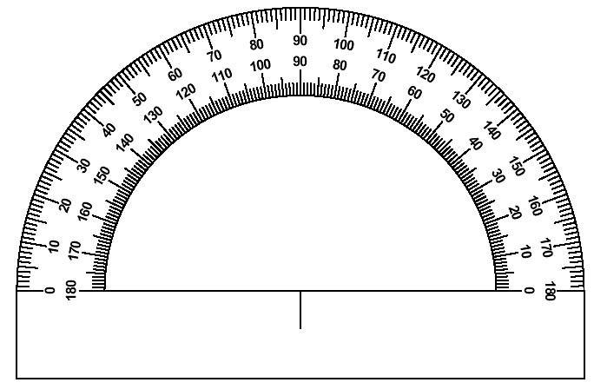
POSTULATE 1-7
Protractor Postulate
●
●
C
D
O

Slide 22
Angle Addition
A
●
1
2
●
●
O
C

Slide 23
Find m∠AOC
A
●
40°
30°
●
●
O
C

Slide 24
Find m∠AOC
●
80°
A
40°
●
●
O
C
130°
●
20°
A
●
●
O
C

Slide 25
Find x.
m∠DEF = 128°
D
●
(6x+5)
(2x+3)
●
●
E
F

Slide 26
Find m∠DOC if m∠AOC= 120º .
120º
A
●
●
D
80°
40°
x
●
●
O
C

Slide 27
Find m∠AOD .
m∠AOC = 130 °
A
●
●
80°
D
x
50°
●
●
O
C

