Slide 1
7-10
Transformations
Warm Up
Problem of the Day
Lesson Presentation
Course 2

Slide 2
7-10
Transformations
Warm Up
1. Subtract 3 from the x-coordinate and 2 from the y-coordinate in (7, –4).
(4, –6)
2. Multiply each coordinate by 3 in (4, 9).
(12, 27)
3. Subtract 4 from the x-coordinate and add 3 to the to the y-coordinate in (–2, –1).
(–6, 2)
Course 2

Slide 3
7-10
Transformations
Problem of the Day
Some numbers appear as different numbers when rotated or reflected. Name as many as you can.
Possible answers: 6 and 9; 6999 and 6669; IV and VI; IX and XI
Course 2

Slide 4
7-10
Transformations
Learn to recognize, describe, and show transformations.
Course 2

Slide 5
Insert Lesson Title Here
7-10
Transformations
Vocabulary
transformation
image
translation
rotation
reflection
line of reflection
Course 2

Slide 6
7-10
Transformations
In mathematics, a transformation
changes the position or orientation of a
figure. The resulting figure is the image
of the original. Images resulting from
the transformations described in the next slides are congruent to the original figures.
Course 2

Slide 7
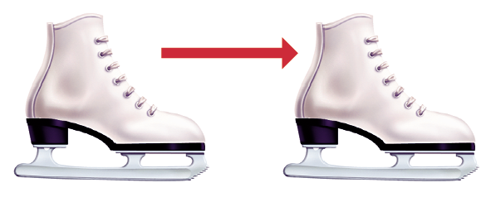
7-10
Transformations
Translation
The figure slides along a straight line without turning.
Course 2

Slide 8
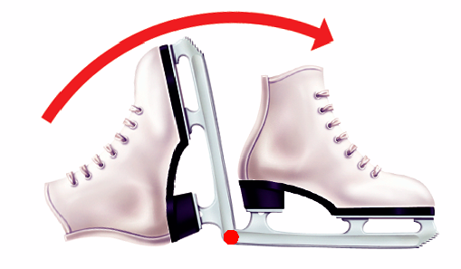
7-10
Transformations
Rotation
The figure turns around a fixed point.
Course 2

Slide 9
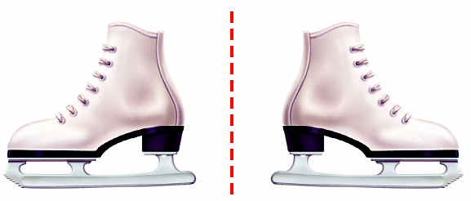
7-10
Transformations
Reflection
The figure flips across a line of reflection, creating a mirror image.
Course 2

Slide 10
7-10
Transformations
Additional Example 1: Identifying Types of Transformations
Identify each type of transformation.
A.
B.
Reflection
Translation
Course 2

Slide 11
Insert Lesson Title Here
7-10
Transformations
Try This: Example 1
Identify each type of transformation.
Translation
Rotation
Helpful Hint
The point that a figure rotates around may be on the figure or away from the figure.
Course 2

Slide 12
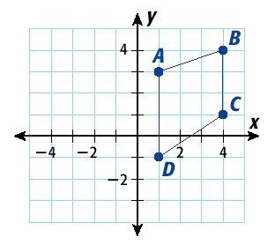
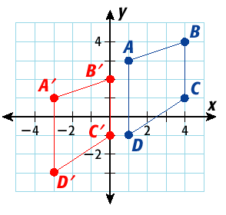
7-10
Transformations
Additional Example 2A: Graphing Transformations on a Coordinate Plane
Graph each transformation.
A. Translate quadrilateral ABCD 4 units left and 2 down.
Each vertex is moved 4 units left and 2 units down.
Course 2

Slide 13
Insert Lesson Title Here
7-10
Transformations
Reading Math
A’ is read “A prime” and is used to represent the point on the image that corresponds to point A of the original figure
Course 2

Slide 14
7-10
Transformations
Additional Example 2B: Graphing Transformations on a Coordinate Plane
B. Rotate ABC 180° around the vertex A.
y
B
2
C’
A
x
–4
– 2
C
2
B’
The corresponding sides, AB and A’B’, lie on a straight line. Notice that the vertex A is the midpoint of the segments BB’ and CC’.
Course 2

Slide 15
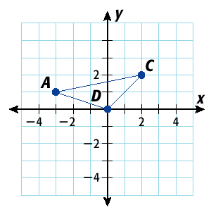
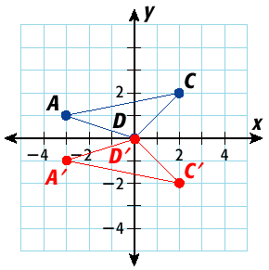
7-10
Transformations
Additional Example 3C: Graphing Transformations on a Coordinate Plane
C. Reflect the figure across the x-axis.
The x-coordinates of the corresponding vertices are the same, and the y-coordinates of the corresponding vertices are opposites.
Course 2

Slide 16
Insert Lesson Title Here
7-10
Transformations
Try This: Example 2A
A. Translate quadrilateral ABCD 5 units left
and 3 units down.
y
B
A
4
B’
2
A’
C
x
–4
–2
D
2
4
–2
C’
D’
–4
Each vertex is moved five units left and three units down.
Course 2

Slide 17
Insert Lesson Title Here
7-10
Transformations
Try This: Example 2B
B. Reflect the figure across the x-axis.
y
B
3
A
C
x
A’
3
C’
–3
B’
The x-coordinates of the corresponding vertices are the same, and the y-coordinates of the corresponding vertices are opposites.
Course 2

Slide 18
Insert Lesson Title Here
7-10
Transformations
Try This: Example 3C
C. Reflect the figure across the y-axis.
y
B’
B
3
A
x
3
–3
C’
C
The y-coordinates of the corresponding vertices are the same, and the x-coordinates of the corresponding vertices are opposites.
Course 2

Slide 19
Transformations
7-10
Insert Lesson Title Here
Lesson Quiz
1. Identify the transformation.
reflection
2. The figure formed by (–5, –6), (–1, –6), and
(3, 2) is transformed 6 units right and 2 units
up. What are the coordinates of the new figure?
(1, –4), (5, –4), (9, 4)
Course 2

