Slide 1
9-1 Mathematical Patterns
Lesson 9.1
Objectives:
The student will be able to identify mathematical patterns.
The student will be able to use a formula for finding the nth term of a sequence.

Slide 2
Generating a Pattern - Phones
Suppose each student in your math class has a phone conversation with every other member of the class. What is the minimum number of calls required?
2 people?
A group of 3?
A group of 4?
A group of 5?
1 call
3 calls
6 calls
10 calls

Slide 3
Generating a Pattern - Phones
1. 2 people?
2. A group of 3?
3. A group of 4?
A group of 5?
What would be a formula used to find the nth term?
What would be a formula used to find the next term?
1 call
3 calls
6 calls
10 calls

Slide 4
Sequence
A sequence is an ordered list of numbers.
You can describe some patterns with a sequence.
Term:
Each number in a sequence.

Slide 5
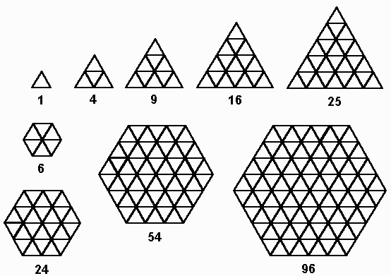
Example 1
What is the pattern of the triangles? Draw the next triangle.
Add 2 more triangles than the previous one.
B. What is the pattern of the hexagons?
Add 12 more triangles than the previous one.

Slide 6
On Own
Describe the pattern formed. Find the next three terms.
27, 34, 41, 48, …
243, 81, 27, 9, …
Pattern: Add 7
55, 62, 69
Pattern: Divide by 3
3, 1, 1/3

Slide 7






Recursive Formula
You can use a variable, such as a, with positive integer subscripts to represent the terms in a sequence.
1st term 2nd term 3rd term … n – 1 term nth term n + 1 term …
$$a_{1}$$
$$a_{2}$$
$$a_{3}$$
…
$$a_{n−1}$$
$$a_{n}$$
$$a_{n+1}$$
…
Recursive Formula:
Defines the terms in a sequence by relating each term to the ones before it.

Slide 8
Example 3
A. Describe the pattern that allows you to find the next term in the sequence 2, 6, 18, 54, 162, … Write a recursive formula for the sequence.
Pattern: Multiply a term by 3 to find the next term.
Recursive Formula: a_{n} = a_{n – 1} • 3, where a₁ = 2.
B. Find the sixth and seventh terms in the sequence.
Since a₅ = 162
a₆ = 162 • 3 = 486
a₇ = 486 • 3 = 1458

Slide 9
Example 3 - Continued
C.
Find the value of a₁₀ in the sequence.
a₁₀ = a₉ • 3
= (a₈ • 3) • 3
= ((a₇ • 3) • 3) • 3
= ((1458 • 3) • 3) • 3
= 39,366

Slide 10
Practice
A. Describe the pattern that allows you to find the next term in the sequence 2, 4, 6, 8, 10, … Write a recursive formula for the sequence.
Pattern: Add 2 to a term to find the next term.
Recursive Formula: a_{n} = a_{n – 1} + 2, where a₁ = 2.
B. Find the sixth and seventh terms in the sequence.
Since a₅ = 10
a₆ = 10 + 2 = 12
a₇ = 12 + 2 = 14

Slide 11
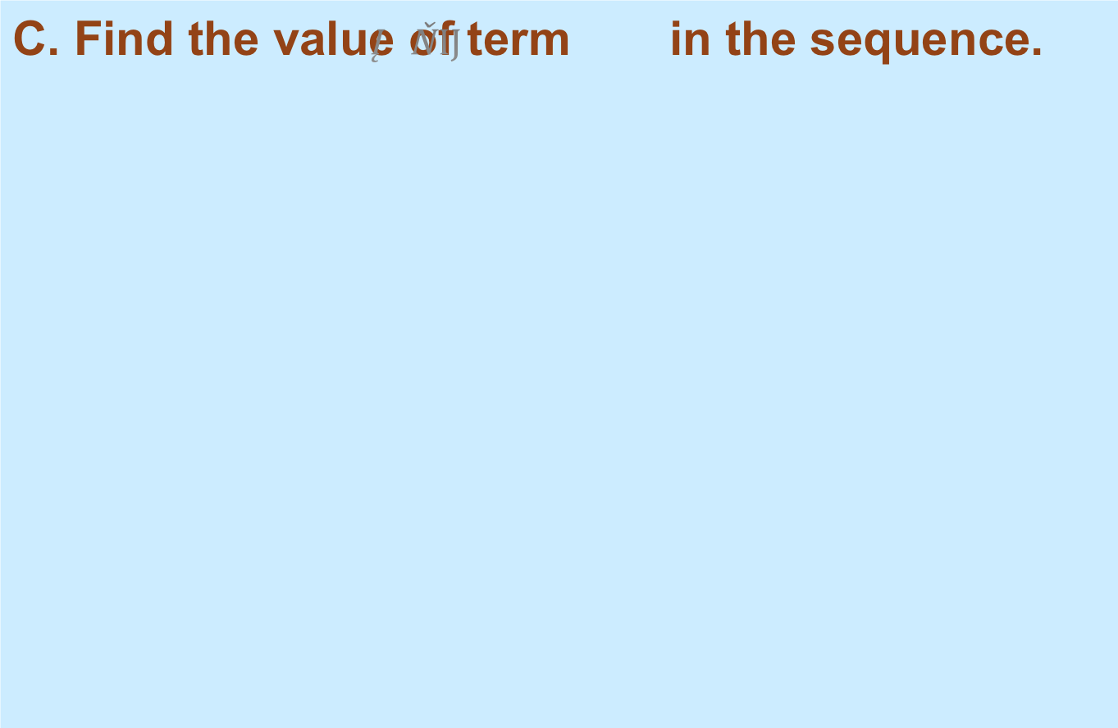


Practice - Continued
C. Find the value of term $a_{9}$ in the sequence.
$$a_{9}= a_{8}+2$$
$$a_{9}= {(a}_{7}+2)+2$$
$$a_{9}=(14+2)+2$$
$$= 18$$

Slide 12
Explicit Formula
Sometimes you can find the value of a term of a sequence without knowing the preceding term.
You can use the number of the term to calculate its value.
Explicit Formula:
A formula that expresses the nth term in terms of n.

Slide 13
Example 4
The spreadsheet shows the perimeters of regular pentagons with sides from 1 to 4 units long. The numbers in each row form a sequence.
A B C D E
1 a₁ a₂ a₃ a₄
2 Length of Side 1 2 3 4
3 Perimeter 5 10 15 20
a. For each sequence, find the next term (a₅) and the twentieth term (a₂₀).
In the sequence in row 2, each term is the same as its subscript.
a₅ = 5
a₂₀ = 20
In the sequence in row 3, each term is 5 times its subscript.
a₅ = 5(5) = 25
a₂₀ = 5(20) = 100

Slide 14
Example 4 - Continued
The spreadsheet shows the perimeters of regular pentagons with sides from 1 to 4 units long. The numbers in each row form a sequence.
A B C D E
1 a₁ a₂ a₃ a₄
2 Length of Side 1 2 3 4
3 Perimeter 5 10 15 20
b. Write an explicit formula for each sequence.
Explicit Formula Row 2: a_{n} = n.
Explicit Formula Row 3: a_{n} = 5n.

Slide 15
Practice
The spreadsheet shows the perimeters of squares with sides from 1 to 4 units long. The numbers in each row form a sequence.
A B C D E
1 a₁ a₂ a₃ a₄
2 Length of Side 1 2 3 4
3 Perimeter 4 8 12 16
a. For each sequence, find the next term (a₇) and the twentieth term (a₂₅).
In the sequence in row 2, each term is the same as its subscript.
a₇ = 7
a₂₅ = 25
In the sequence in row 3, each term is 4 times its subscript.
a₅ = 4(7) = 28
a₂₀ = 4(25) = 100

Slide 16
Practice
The spreadsheet shows the perimeters of squares with sides from 1 to 4 units long. The numbers in each row form a sequence.
A B C D E
1 a₁ a₂ a₃ a₄
2 Length of Side 1 2 3 4
3 Perimeter 4 8 12 16
b. Write an explicit formula for each sequence.
Explicit Formula Row 2: a_{n} = n.
Explicit Formula Row 3: a_{n} = 4n.

Slide 17
Knowledge Quiz
Describe each pattern. Find the next three terms.
1. 5, 15, 25, 35, . . .
2
3
4
9
8
27
2. 1, , , , . . .
3. Write a recursive formula for the sequence: 7, –1, –9, –17, . . .. Then find the next term.
4. Write an explicit formula for the sequence: 12, 20, 28, 36, . . . Then find the next term.

Slide 18
9-2 Arithmetic Sequences
Today’s objective
Students will define and identify arithmetic sequences and find the next terms and determine whether each sequence is arithmetic or not… also will identify the common differences and the arithmetic mean of two numbers in the sequence.

Slide 19
REAL WORLD APPLICATION
GETTING READY – Let’s get motivated!
PREPARING FOR TRAINING IN ANY FIELD SUCH AS SPORTS, COSMOTOLOGY, FINANCE, ETC…
LET’S THINK ABOUT REAL WORLD SENARIOS…..

Slide 20
Essential TN Ready Vocabulary
An arithmetic sequence is a sequence where the difference between consecutive terms is constant.
This difference is called the common difference.
Example 1: “I DO”
3, 8, 13, 18,… Determine whether this sequence is arithmetic?
EX 2: 1, 5, 9, 13, 17,… “WE DO” Is this arithmetic?
EX 3: 2, 3, 5, 8,… “You Do” Is this arithmetic?

Slide 21
How do I know if it is an arithmetic sequence?
Look for a common difference between consecutive terms
Ex: 2, 4, 8, 16 . . .
Common Difference?
2+2 = 4
4+ 4 = 8
8 + 8 = 16
No. The sequence is NOT Arithmetic
Ex: 48, 45, 42, 39 . . .
Common Difference?
48 - 3 = 45
45 - 3 = 42
42 - 3 = 39
Yes. The sequence IS Arithmetic. Subtract 3 each time

Slide 22
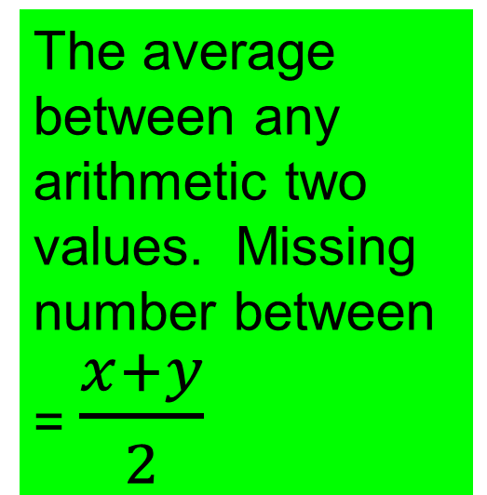
Important Formulas for
Arithmetic Sequence:
Recursive Formula
Explicit Formula
a_{n} = a_{n} _{– 1} + d
a_{n} = a₁ + (n-1)d
Arithmetic Mean
Where:
a_{n} is the nth term in the sequence
a₁ is the first term
n is the number of the term
d is the common difference
The average between any arithmetic two values. Missing number between = $\frac{x+y}{2}$

Slide 23
Formula
My formula for finding any term in an arithmetic sequence is a_{n} = a₁ + d(n-1).
All you need to know to find any term is the first term in the sequence (a₁) and the common difference.

Slide 24
Example
Let’s go back to our first example about the radio contest. Suppose no one correctly answered the question for 15 days. What would the prize be on day 16?

Slide 25
Example
a_{n} = a₁ + d(n-1)
We want to find a₁₆. What is a₁? What is d? What is n-1?
a₁ = 150, d = 150, n -1 = 16 - 1 = 15
So a₁₆ = 150 + 150(15) =
$2400

Slide 26
Example
17, 10, 3, -4, -11, -18, …
What is the common difference?
Subtract any term from the term after it.
-4 - 3 = -7
d = - 7

Slide 27
How does this work:
Start with the easy one:
Find the missing term of the arithmetic sequence 84, ____ , 110
Strategy: Find the average
84 + 110 = 97
2

Slide 28
Definition
17, 10, 3, -4, -11, -18, …
Arithmetic Means: the terms between any two nonconsecutive terms of an arithmetic sequence.

Slide 29
Arithmetic Means
17, 10, 3, -4, -11, -18, …
Between 10 and -18 there are three arithmetic means 3, -4, -11.
Find three arithmetic means between 8 and 14.

Slide 30
Arithmetic Means
So our sequence must look like 8, __, __, __, 14.
In order to find the means we need to know the common difference. We can use our formula to find it.

Slide 31
Arithmetic Means
8, __, __, __, 14
a₁ = 8, a₅ = 14, & n = 5
14 = 8 + d(5 - 1)
14 = 8 + d(4) subtract 8
6 = 4d divide by 4
1.5 = d

Slide 32
Arithmetic Means
8, __, __, __, 14 so to find our means we just add 1.5 starting with 8.
8, 9.5, 11, 12.5, 14

Slide 33
Additional Example
72 is the __ term of the sequence -5, 2, 9, …
We need to find ‘n’ which is the term number.
72 is a_{n}, -5 is a₁, and 7 is d. Plug it in.

Slide 34
Additional Example
72 = -5 + 7(n - 1)
72 = -5 + 7n - 7
72 = -12 + 7n
84 = 7n
n = 12
72 is the 12th term.

Slide 35
Ex: Write the explicit and recursive formula for each sequence
2, 4, 6, 8, 10
First term: a₁ = 2
difference = 2
Explicit:
a_{n} = a₁ + (n-1)d
an = 2 + (n-1)2
a_{n} = a_{n} _{– 1} + 2, where a₁ = 2
Recursive:
a_{n} = a_{n} _{– 1} + d

Slide 36
Explicit Arithmetic Sequence Problem
Find the 25th term in the sequence of 5, 11, 17, 23, 29 . . .
a_{n} = a₁ + (n-1)d
Start with the explicit sequence formula
difference = 6
Find the common difference between the values.
a₂₅ = 5 + (25 -1)6
Plug in known values
a₂₅ = 5 + (24)6 =149
Simplify

Slide 37
Now you try one:
Find the 25th term of the arithmetic sequence: 26, 13, 0, -13

Slide 38
Explicit Arithmetic Sequence Problem
Find the 25th term of the arithmetic sequence: 26, 13, 0, -13
a_{n} = a₁ + (n-1)d
Start with the explicit sequence formula
difference = -13
Find the common difference between the values.
a₂₅ = 26 + (25 -1)(-13)
Plug in known values
a₂₅ = 26 + (24)(-13) =-286
Simplify

Slide 39
9-3 Geometric Sequences

Slide 40
What is a Geometric Sequence?
In a geometric sequence, the ratio between consecutive terms is constant. This ratio is called the common ratio.
Unlike in an arithmetic sequence, the difference between consecutive terms varies.
We look for multiplication to identify geometric sequences.

Slide 41
Ex: Determine if the sequence is geometric. If so, identify the common ratio
1, -6, 36, -216
yes. Common ratio=-6
2, 4, 6, 8
no. No common ratio

Slide 42
Geometric Sequence
Find the first five terms of the geometric sequence with a₁ = -3 and common ratio (r) of 5.
-3, -15, -75, -375, -1875

Slide 43
Geometric Sequence
Find the common ratio of the sequence 2, -4, 8, -16, 32, …
To find the common ratio, divide any term by the previous term.
8 ÷ -4 = -2
r = -2

Slide 44
Geometric Sequence
Just like arithmetic sequences, there is a formula for finding any given term in a geometric sequence. Let’s figure it out using the pay check example.

Slide 45
Geometric Sequence
To find the 5th term we look 100 and multiplied it by two four times.
Repeated multiplication is represented using exponents.

Slide 46
Geometric Sequence
Basically we will take $100 and multiply it by 2⁴
a₅ = 100•2⁴ = 1600
A₅ is the term we are looking for, 100 was our a₁, 2 is our common ratio, and 4 is n-1.

Slide 47
Examples
Thus our formula for finding any term of a geometric sequence is a_{n} = a₁•r^{n-1}
Find the 10th term of the geometric sequence with a₁ = 2000 and a common ratio of ¹/₂.

Slide 48
Examples
a₁₀ = 2000• (¹/₂)⁹ =
2000 • ¹/₅₁₂ =
²⁰⁰⁰/₅₁₂ = ⁵⁰⁰/₁₂₈ = ²⁵⁰/₆₄ = ¹²⁵/₃₂
Find the next two terms in the sequence -64, -16, -4 ...

Slide 49
Examples
-64, -16, -4, __, __
We need to find the common ratio so we divide any term by the previous term.
-16/-64 = 1/4
So we multiply by 1/4 to find the next two terms.

Slide 50
Examples
-64, -16, -4, -1, -1/4

Slide 51
Important Formulas for
Geometric Sequence:
Recursive Formula
Explicit Formula
a_{n} = (a_{n} _{– 1} ) r
a_{n} = a₁ * r ^{n-1}
Geometric Mean
Where:
a_{n} is the nth term in the sequence
a₁ is the first term
n is the number of the term
r is the common ratio
Find the product of the two values, x & y, and then take the square root of the answer.
Missing term in between = √xy

Slide 52


Let’s start with the geometric mean
Find the geometric mean between 3 and 48
Let’s try one: Find the geometric mean between 28 and 5103

Slide 53
Geometric Means
Just like with arithmetic sequences, the missing terms between two nonconsecutive terms in a geometric sequence are called geometric means.

Slide 54
Geometric Means
Looking at the geometric sequence 3, 12, 48, 192, 768 the geometric means between 3 and 768 are 12, 48, and 192.
Find two geometric means between -5 and 625.

Slide 55
Geometric Means
-5, __, __, 625
We need to know the common ratio. Since we only know nonconsecutive terms we will have to use the formula and work backwards.

Slide 56
Geometric Means
-5, __, __, 625
625 is a₄, -5 is a₁.
625 = -5•r⁴⁻¹ divide by -5
-125 = r³ take the cube root of both sides
-5 = r

Slide 57
Geometric Means
-5, __, __, 625
Now we just need to multiply by -5 to find the means.
-5 • -5 = 25
-5, 25, __, 625
25 • -5 = -125
-5, 25, -125, 625

Slide 58

Ex: Write the explicit formula for each sequence
First term: a₁ = 7
Common ratio = 1/3
Explicit:
a_{n} = a₁ * r ^{n-1}
a₁ = 7(1/3) ⁽¹⁻¹⁾ = 7
a₂ = 7(1/3) ⁽²⁻¹⁾ = 7/3
a₃ = 7(1/3) ⁽³⁻¹⁾ = 7/9
a₄ = 7(1/3) ⁽⁴⁻¹⁾ = 7/27
a₅ = 7(1/3) ⁽⁵⁻¹⁾ = 7/81
Now find the first five terms:

Slide 59
Explicit Geometric Sequence Problem
Find the 19th term in the sequence of 11,33,99,297 . . .
a_{n} = a₁ * r ^{n-1}
Start with the explicit sequence formula
Common ratio = 3
Find the common ratio between the values.
a₁₉ = 11 (3) ⁽¹⁹⁻¹⁾
Plug in known values
a₁₉ = 11(3)¹⁸ =4,261,626,379
Simplify

Slide 60
Let’s try one
Find the 10th term in the sequence of 1, -6, 36, -216 . . .
a_{n} = a₁ * r ^{n-1}
Start with the explicit sequence formula
Common ratio = -6
Find the common ratio between the values.
a₁₀ = 1 (-6) ⁽¹⁰⁻¹⁾
Plug in known values
a₁₀ = 1(-6)⁹ = -10,077,696
Simplify

Slide 61
9-4
Arithmetic
Series

Slide 62
Arithmetic Series
The African-American celebration of Kwanzaa involves the lighting of candles every night for seven nights. The first night one candle is lit and blown out.

Slide 63
Arithmetic Series
The second night a new candle and the candle from the first night are lit and blown out. The third night a new candle and the two candles from the second night are lit and blown out.

Slide 64
Arithmetic Series
This process continues for the seven nights.
We want to know the total number of lightings during the seven nights of celebration.

Slide 65
Arithmetic Series
The first night one candle was lit, the 2nd night two candles were lit, the 3rd night 3 candles were lit, etc.
So to find the total number of lightings we would add: 1 + 2 + 3 + 4 + 5 + 6 + 7

Slide 66
Arithmetic Series
1 + 2 + 3 + 4 + 5 + 6 + 7 = 28
Series: the sum of the terms in a sequence.
Arithmetic Series: the sum of the terms in an arithmetic sequence.

Slide 67
Arithmetic Series
Arithmetic sequence: 2, 4, 6, 8, 10
Corresponding arith. series: 2 + 4 + 6 + 8 + 10
Arith. Sequence: -8, -3, 2, 7
Arith. Series: -8 + -3 + 2 + 7

Slide 68
Arithmetic Series
S_{n} is the symbol used to represent the first ‘n’ terms of a series.
Given the sequence 1, 11, 21, 31, 41, 51, 61, 71, … find S₄
We add the first four terms 1 + 11 + 21 + 31 = 64

Slide 69
Arithmetic Series
Find S₈ of the arithmetic sequence 1, 2, 3, 4, 5, 6, 7, 8, 9, 10, …
1 + 2 + 3 + 4 + 5 + 6 + 7 + 8 =
36

Slide 70
Arithmetic Series
What if we wanted to find S₁₀₀ for the sequence in the last example. It would be a pain to have to list all the terms and try to add them up.
Let’s figure out a formula!! :)

Slide 71
Sum of Arithmetic Series
Let’s find S₇ of the sequence 1, 2, 3, 4, 5, 6, 7, 8, 9, …
If we add S₇ in too different orders we get:
S₇ = 1 + 2 + 3 + 4 + 5 + 6 + 7
S₇ = 7 + 6 + 5 + 4 + 3 + 2 + 1
2S₇ = 8 + 8 + 8 + 8 + 8 + 8 + 8

Slide 72
Sum of Arithmetic Series
S₇ = 1 + 2 + 3 + 4 + 5 + 6 + 7
S₇ = 7 + 6 + 5 + 4 + 3 + 2 + 1
2S₇ = 8 + 8 + 8 + 8 + 8 + 8 + 8
2S₇ = 7(8)
S₇ =⁷/₂(8)
7 sums of 8

Slide 73
Sum of Arithmetic Series
S₇ =⁷/₂(8)
What do these numbers mean?
7 is n, 8 is the sum of the first and last term (a₁ + a_{n})
So S_{n} = ^{n}/₂(a₁ + a_{n})

Slide 74
Examples
S_{n} = ^{n}/₂(a₁ + a_{n})
Find the sum of the first 10 terms of the arithmetic series with a₁ = 6 and a₁₀ =51
S₁₀ = 10/2(6 + 51) = 5(57) = 285

Slide 75
Examples
Find the sum of the first 50 terms of an arithmetic series with a₁ = 28 and d = -4
We need to know n, a₁, and a₅₀.
n= 50, a₁ = 28, a₅₀ = ?? We have to find it.

Slide 76
Examples
a₅₀ = 28 + -4(50 - 1) = 28 + -4(49) = 28 + -196 = -168
So n = 50, a₁ = 28, & a_{n} =-168
S₅₀ = (50/2)(28 + -168) = 25(-140) = -3500

Slide 77
Examples
To write out a series and compute a sum can sometimes be very tedious. Mathematicians often use the greek letter sigma & summation notation to simplify this task.

Slide 78
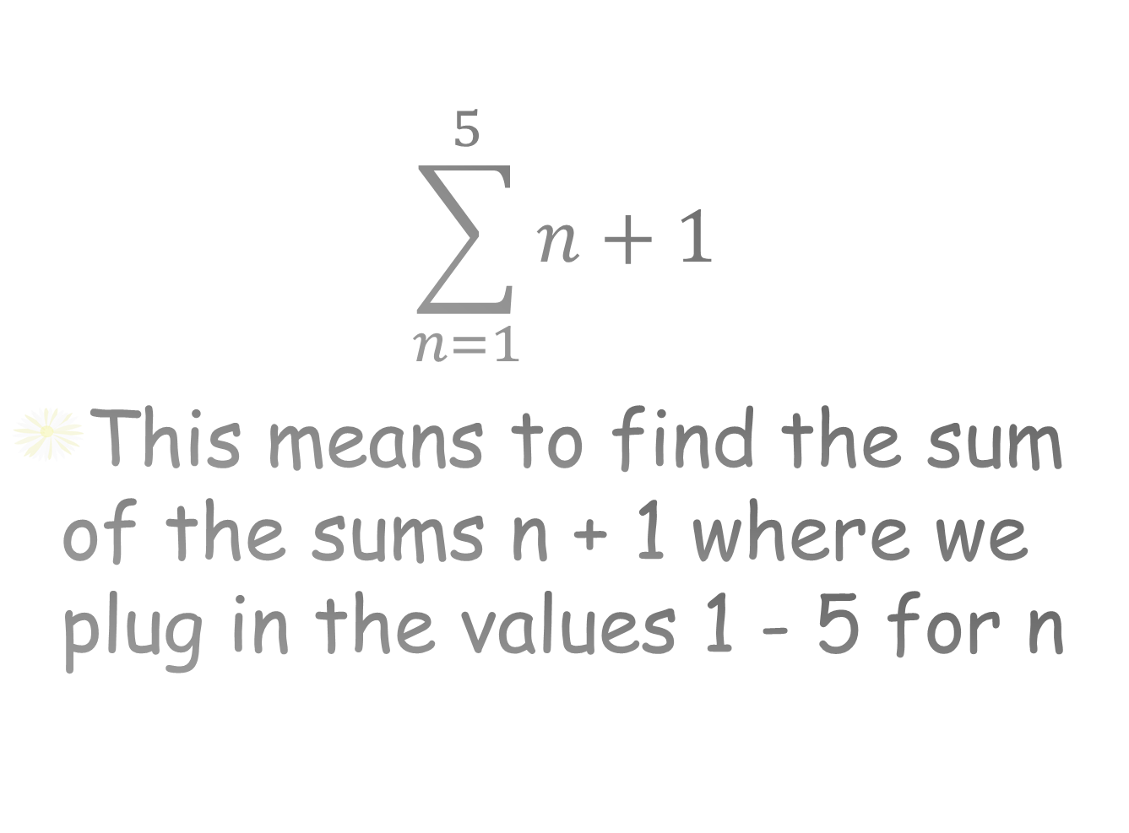
Examples
$$\sum_{n=1}^{5}{n+1}$$
This means to find the sum of the sums n + 1 where we plug in the values 1 - 5 for n
last value of n
formula used to find sequence
First value of n

Slide 79
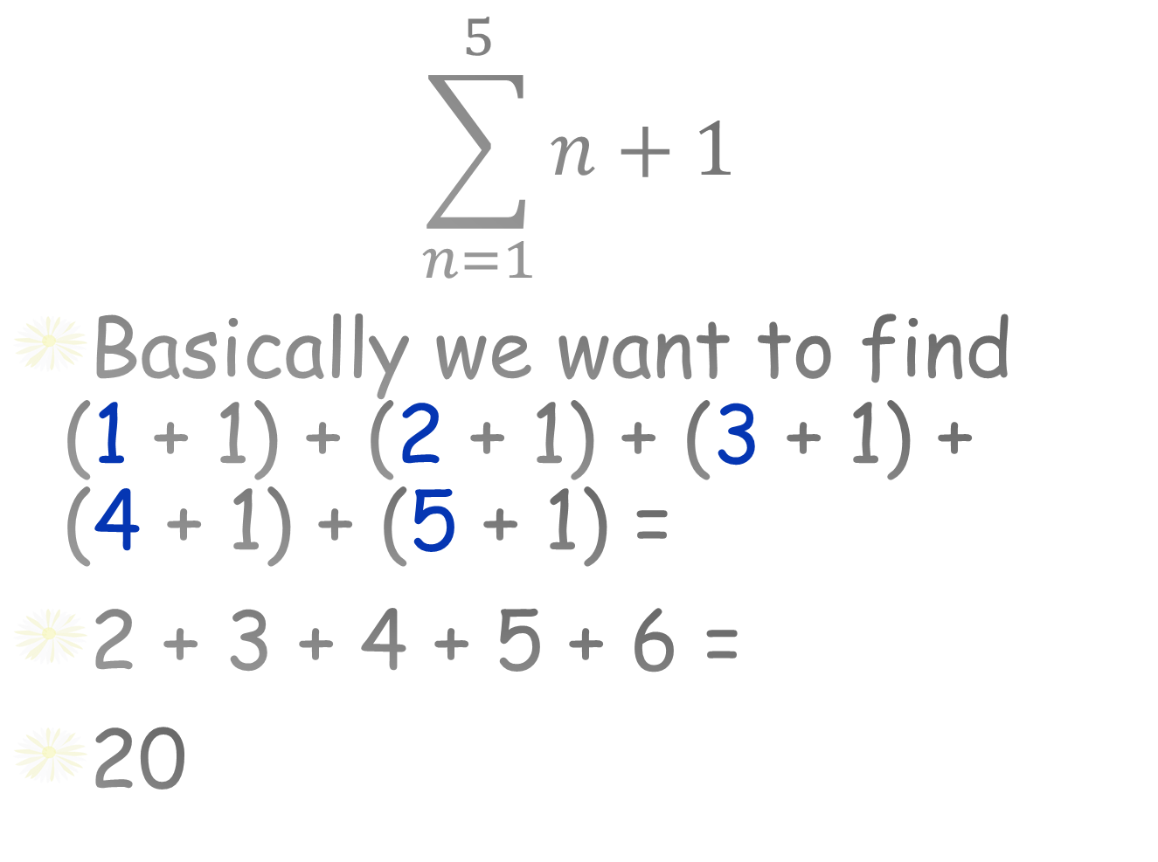
Examples
$$\sum_{n=1}^{5}{n+1}$$
Basically we want to find (1 + 1) + (2 + 1) + (3 + 1) + (4 + 1) + (5 + 1) =
2 + 3 + 4 + 5 + 6 =
20

Slide 80
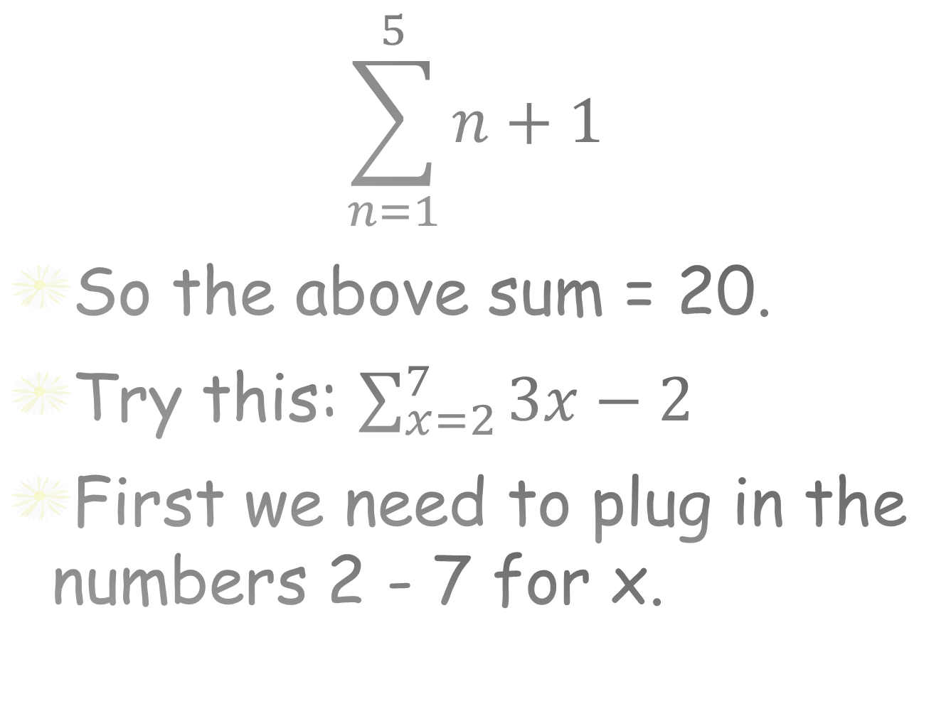
Examples
$$\sum_{n=1}^{5}{n+1}$$
So the above sum = 20.
Try this: $\sum_{x=2}^{7}{3x−2}$
First we need to plug in the numbers 2 - 7 for x.

Slide 81
Examples
[3(2)-2]+[3(3)-2]+[3(4)-2]+ [3(5)-2]+[3(6)-2]+[3(7)-2] =
(6-2)+(9-2)+(12-2)+(15-2)+ (18-2)+ (21-2) =
4 + 7 + 10 + 13 + 17 + 19 = 70

Slide 82
9-5
Geometric
Series

Slide 83
Geometric Series
Geometric Series - the sum of the terms of a geometric sequence.
Geo. Sequence: 1, 3, 9, 27, 81
Geo. Series: 1+3 + 9 + 27 + 81
What is the sum of the geometric series?

Slide 84
Geometric Series
1 + 3 + 9 + 27 + 81 = 121
The formula for the sum S_{n} of the first n terms of a geometric series is given by

Slide 85
Geometric Series
Find
You can actually do it two ways. Let’s use the old way.
Plug in the numbers 1 - 4 for n and add.
[-3(2)¹⁻¹]+[-3(2)²⁻¹]+[-3(2)³⁻¹]+ [-3(2)⁴⁻¹]

Slide 86
Geometric Series
[-3(1)] + [-3(2)] + [-3(4)] + [-3(8)] =
-3 + -6 + -12 + -24 = -45
The other method is to use the sum of geometric series formula.

Slide 87
Geometric Series
use
a₁ = -3, r = 2, n = 4

Slide 88
Geometric Series
use
a₁ = -3, r = 2, n = 4

Slide 89
Geometric Series

