Slide 1
Chapter 8 Rational Functions
Unit Essential Questions:
Are two quantities inversely proportional if an increase in one corresponds to a decrease in the other?
What kind of asymptotes are possible for a rational function?
Are a rational expression and its simplified form equivalent?

Slide 2
Section 8.1 Inverse Variation
Students will be able to recognize and use inverse variation
Students will be able to use joint and other variations

Slide 3
Warm Up
Suppose y varies directly with x.
Given that x = 2 when y = 4, find y when x = 5.
y = 10
2. Given that x = 1 when y = 5, find y when x = 3.
y = 15
3. Given that x = 10 when y = 3, find y when x = 4.
y = 6/5 or 1.2

Slide 4
Key Concepts
Inverse Variation - a function of the form y = k/x, x=k/y, or xy = k, where k ≠ 0.

Slide 5
Example 1
Is the relationship between the variables a direct variation, an inverse variation, or neither? Write function a models for the direct and inverse variations.
a. b. c.
x | y
2 | 0.7
4 | 0.35
7 | 0.2
14 | 0.1
x | y
-2 | 6
-1.3 | 5
7 | -4
10 | -15
x | y
-2 | 5
4 | -10
6 | -15
8 | -20
y varies inversely with x.
y = 1.4/x
Neither
y varies directly with x.
y = -2.5x

Slide 6
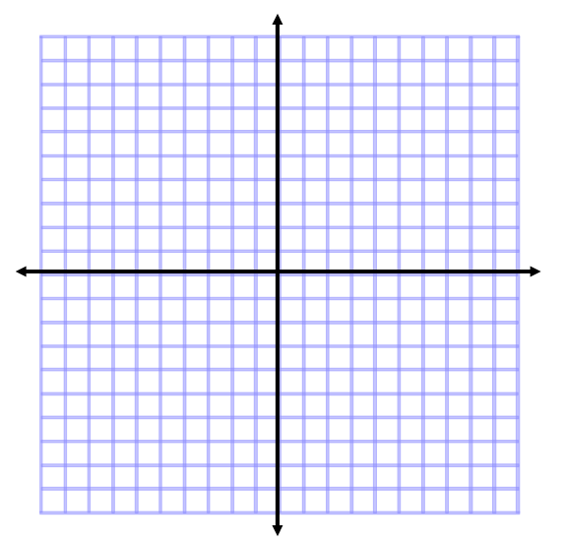
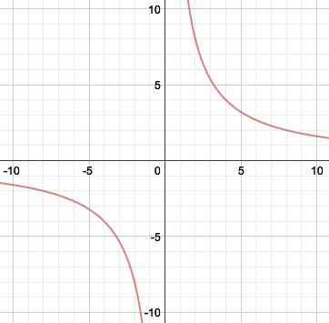
Example 2
Suppose that x and y vary inversely, and x = 2 when y = 8.
Write the function that models each inverse variation.
b. Graph the function
c. Find y when x = 4.
k = xy
k = (2)(8)
k = 16

Slide 7
Key Concepts
Combined Variation – combines direct and inverse variations in more complicated relationships
Joint Variation – one quantity varies directly with 2 or more quantities
Combined Variation | Equation Form
z varies jointly with x and y
z varies jointly with x and y and inversely with w
z varies directly with x and inversely with the product wy

Slide 8
Example 3
z varies directly with x and inversely with y. When x = 8 and y = 2, z = 12. Write the function that models the variation. Find z when x = 4 and y = 6.
Write the function that models the variation.
Find z when x = 4 and
y = 6.
Find k.

Slide 9
Example 4
z varies jointly with x and y. When x = 5 and y = 3, z = 60. Write the function that models the variation. Find z when x = 5 and y = 0.25.
Write the function that models the variation.
Find z when x = 5 and
y = 0.25.
Find k.

Slide 10
Section 8.2 The Reciprocal Function Family
Students will be able to graph reciprocal functions
Students will be able to graph translations of reciprocal functions

Slide 11
Warm Up
Each of the following equations is a translation of
y = |x|. Describe each translation.
y = |x| + 2 2. y = |x + 2|
y = |x| – 3 4. y = |x – 3|
5. y = |x + 4| – 5 6. y = |x – 10| + 7
Up 2 units
Left 2 units
Down 3 units
Right 3 units
Down 5 units,
Left 4 units
Up 7 units,
Right 10 units

Slide 12
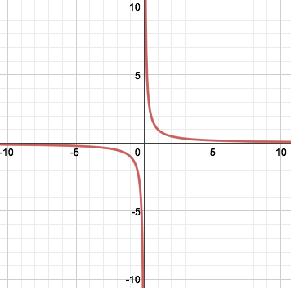
Example 1
Graph using a table of values.
x | y
-3 | -1/3
-2 | -1/2
-1 | -1
0
1 | 1
2 | 1/2
3 | 1/3

Slide 13
Key Concepts
Reciprocal Function – belongs to the family whose parent is
Branch – each part of the graph of a reciprocal function.
The line x = h is a vertical asymptote and is a horizontal translation.
The line y = k is a horizontal asymptote and is a vertical translation.

Slide 14
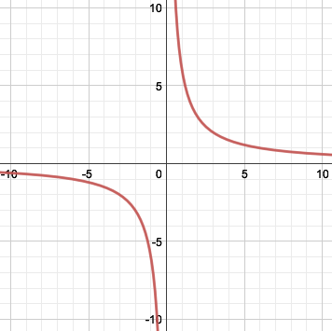
Example 2
Graph . Identify the x- and y- intercepts and the asymptotes of the graph. Also, state the domain and range.
The x-axis and
y-axis are the asymptotes.
x | y
-3 | -2
-2 | -3
-1 | -6
0
1 | 6
2 | 3
3 | 2
There is no x- or y- intercepts.
Domain: All real numbers except x = 0
Range: All real numbers except y = 0

Slide 15
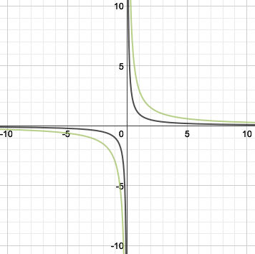
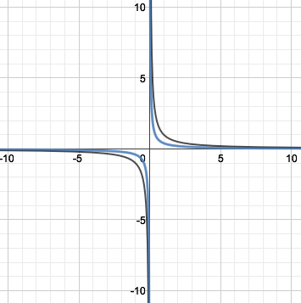
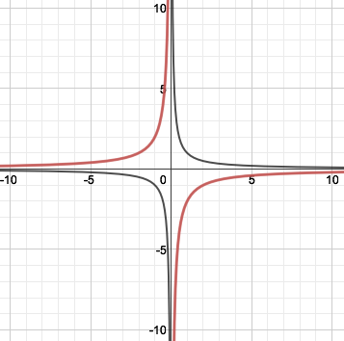
Example 3
Using a graphing calculator, graph the equations and using the given values of a. How does the value of a change the graph?
a = 3
Stretched by 3
b. a = 0.4
Compressed by 0.4
c. a = -2
Stretched by 2
Reflected across the x-axis

Slide 16
Key Concepts
Transformations of
Vertical Translation (k units) Up: Down: | Horizontal Translation (h units) Right: Left:
Vertical Stretch/Compression Stretch (a>1): Compression (0<a<1): | Reflection x-axis: ===== -----

Slide 17
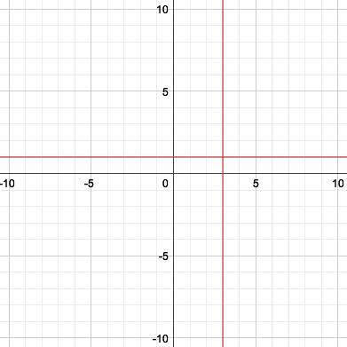
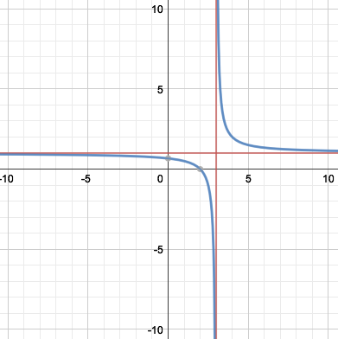
Example 4
What is the graph of ? Identify the domain and range.
Draw the asymptotes.
Since h = 3 and k = 1,
Vertical asymptote: x = 3
Horizontal asymptote: y = 1
Translate the graph of
3 units left and 1 unit up.
Domain is all real numbers except x = 3.
Range is all real numbers except y = 1.

Slide 18
Example 5
Write an equation for the translation of
that has asymptotes at x = -1 and y = -7.
Since the asymptotes are
x = -1 and y = -7,
h = -1 and k = -7
Use the general form of a reciprocal function
Substitute a, h, and k.
Simplify.

Slide 19
Section 8.3 Rational Functions and Their Graphs
Students will be able to identify properties of rational functions
Students will be able to graph rational functions

Slide 20
Warm Up
Factor.
1. x² + 5x + 6 2. x² – 6x + 8
(x + 3)(x + 2) (x – 4)(x – 2)
Factor and Solve.
3. x² + x – 12 = 0 4. x² – 9x + 18 = 0
(x + 4)(x – 3) = 0 (x – 6)(x – 3) = 0
x = -4, 3 x = 3, 6

Slide 21
Key Concepts
Rational Function – a function that you can write
in the form
Continuous Graph – a graph that has no breaks, jumps, or holes. (You can draw the graph without picking up you pencil)
Discontinuous Graph – a graph that has jumps, breaks or holes.

Slide 22
Key Concepts
Point of Discontinuity – the point at which the graph is not continuous (x = a)
Steps to Find Points of Discontinuity:
Factor (if possible)
Set denominator = 0, solve for points of discontinuity (x = a)
If a point of discontinuity is a factor of the numerator, then the function has Removable Discontinuity or x = a is a Hole.
If a point of discontinuity is NOT a factor of the numerator, then the function has Non-removable Discontinuity or x = a is an Asymptote.

Slide 23
Example 1
Use following rational function.
What is the domain of the rational function?
Identify the points of discontinuity. Are the points of discontinuity removable or non-removable?
What are the x- and y – intercepts?
Since the function is undefined where x = 4, and x = -3, the domain is all real numbers except x = 4 and x = -3.
Factor
Set denominator = 0 and solve
There are two points of non-removable discontinuity at x = 4 and x = -3
x-intercept
y-intercept

Slide 24
Example 2
Use following rational function.
What is the domain of the rational function?
Identify the points of discontinuity. Are the points of discontinuity removable or non-removable?
What are the x- and y – intercepts?
Since no real number makes the denominator = 0, the domain is all real numbers.
Factor
Set denominator = 0 and solve
There are no discontinuities.
x-intercept
y-intercept

Slide 25
Example 3
Use following rational function.
What is the domain of the rational function?
Identify the points of discontinuity. Are the points of discontinuity removable or non-removable?
What are the x- and y – intercepts?
Since the function is undefined where x = -2, the domain is all real numbers except x = -2.
Factor
Set denominator = 0 and solve
There is points of removable discontinuity at x = -2
x-intercept
y-intercept

Slide 26
Key Concepts
Vertical Asymptotes of Rational Functions – the graph has a vertical asymptote at x = a if it has non-removable discontinuity at x = a.

Slide 27
Example 4
What are the vertical asymptotes for the graph of
a.
b.
Since -2 and 3 are roots of the denominator but not roots of the numerator, the lines x = -2 and x = 3 are vertical asymptotes.
Since -2 is a root of the denominator but not a root of the numerator, the line x = -2 is a vertical asymptote.
Since -7 is a root of the numerator and denominator, there is a hole at x = -7.

Slide 28
Key Concepts
Horizontal Asymptote of a Rational Function – to find a horizontal asymptote, compare the degree of the numerator to the degree of the denominator.
Degree of numerator < degree of denominator:
Horizontal Asymptote: y=0
Degree of numerator = degree of denominator:
Horizontal Asymptote: y= ratio of leading coefficients
Degree of numerator > degree of denominator:
Horizontal Asymptote: No Horizontal Asymptote

Slide 29
Example 5
What are the horizontal asymptote for the graph of
a.
b.
c.
degree = 1
degree = 1
degree = 1
degree = 2
degree = 2
degree = 1

Slide 30
Key Concepts
Steps to Graphing a Rational Function:
Find the horizontal asymptote (if there is one) using the rules for determining the horizontal asymptote of a rational function.
Factor both the numerator and denominator
Find any vertical asymptote(s) by setting the denominator = 0 and solving for x.
Find the y-intercept (if there is one) by evaluating f (0).
Find the x-intercepts (if there are any) by setting the numerator = 0 and solving for x.
Find a few more points on the graph.

Slide 31
Example 6
What is the graph of the rational function
Find Horizontal Asymptotes
Degree 1
Degree 2
Factor
x-intercept
y-intercept

Slide 32
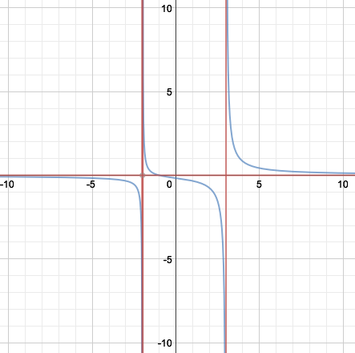
Example 6 (Continued)
Find a few more points

Slide 33
Section 8.4 Rational Expressions
Students will be able to simplify expressions
Students will be able to multiply and divide rational expressions

Slide 34
Warm Up
Factor.
2x² - 3x + 1
(2x – 1)(x – 1)
2. 4x² – 9
(2x – 3)(2x + 3)
3. 5x² + 6x + 1
(5x + 1)(x + 1)

Slide 35
Key Concepts
Rational Expression – the quotient of two polynomials.
Simplest Form – the numerator and denominator of a rational expression have no common factor

Slide 36
Example 1
What is in simplest form? State restrictions on the variable.
Factor
Divide out common factors
Simplify

Slide 37
Example 2
What is the product in simplest form? State any restrictions on the variable.
Factor
Divide out common factors
Simplify

Slide 38
Example 3
What is the quotient in simplest form? State any restrictions on the variable.
Multiply by the reciprocal
Factor
Divide out common factors
Simplify

Slide 39
Section 8.5 Part 1 Rational Expressions
Students will be able to add and subtract rational expressions

Slide 40
Warm Up
Add or Subtract.
1. 2.

Slide 41
Key Concepts
Steps to Add or Subtract Rational Expressions:
Find the LCD of the rational expressions.
Write each rational expression as an equivalent rational expression whose denominator is the LCD found in Step 1.
Add or subtract numerators, and write the result over the denominator.
Simplify resulting rational expression, if possible.

Slide 42
Example 1
What is the least common multiple (LCM) of 2x² - 8x + 8 and 15x² - 60.
Find the prime factors of each expression
Identify the greatest power of each factor in each expression
Least Common Multiple

Slide 43
Example 2
What is the sum of the two rational expressions in simplest form?
Factor
Rewrite with a common denominator
Simplify
Add numerators

Slide 44
Example 3
What is the difference of the two rational expressions in simplest form?
Factor
Rewrite with a common denominator
Simplify
Add numerators

Slide 45
Section 8.5 Part 2 Rational Expressions
Students will be able to add and subtract rational expressions

Slide 46
Warm Up
Find the least common multiple of the two numbers.
7, 21
21
2. 6, 10
30
3. 11, 17
187

Slide 47
Key Concepts
Complex Fraction - a fraction that has a fraction in its numerator or denominator or in both its numerator and denominator.

Slide 48
Example 1
What is the simplest form of the complex fraction?
Rewrite with a common denominator
Add
numerators
Multiply by the reciprocal
Simplify
Simplify

Slide 49
Example 2
What is the simplest form of the complex fraction?
Rewrite with a common denominator
Add
numerators
Multiply by the reciprocal
Simplify
Simplify

Slide 50
Section 8.6 Solving Rational Equations
Students will be able to solve rational equations

Slide 51
Warm Up
Solve.
x + 3 = 20
x = 17
2. 2x - 7 = 13
x = 10
x² + 4x - 12=0
x = -6, 2

Slide 52
Key Concepts
Rational Equation – an equation that contains at least one rational expression.
Steps to Solve a Rational Equation:
Factor the denominators
Multiply each side by the LCD
Simplify
Solve
Check for extraneous solutions
Rational Equation
Not a Rational Equation

Slide 53
Example 1
What are the solutions of the rational equation?
Factor
Multiply both sides by LCD
Simplify
Solve

Slide 54
Example 1 (Continued)
Check
Solutions are

Slide 55
Example 2
What are the solutions of the rational equation?
Factor
Multiply both sides by LCD
Simplify
Solve

Slide 56
Example 2 (Continued)
Check
Since x cannot equal -1, due to restrictions on the domain, there is no solution

