Slide 1
Chapter 5 Polynomials and Polynomial Functions
Unit Essential Questions:
What does the degree of a polynomial tell you about its related polynomial function?
For a polynomial function, how are factors, zeros and x-intercepts related?
For a polynomial equation, how are factors and roots related?

Slide 2
Section 5.1 Polynomial Functions
Students will be able to classify polynomials
Students will be able to graph polynomial functions and describe end behavior

Slide 3
Warm Up
Simplify each expression by combining like terms.
3x + 5x – 7x
x
–8xy² – 2x²y + 5x²y
-8xy² + 3x²y
–4x + 7x² + x
7x² – 3x

Slide 4
Key Concepts
Monomial – a real number, a variable, or a product of a real number and one or more variables with whole number exponents
Degree of a Monomial – the exponent of the variable
Polynomial – a monomial or the sum of monomials
Degree of a Polynomial – the largest degree of any term of the polynomial.

Slide 5
Key Concepts
Standard Form of a Polynomial – arranges the terms by degree in a descending numerical order
where n is a nonnegative integer and a_{n},….,a₀ are real numbers

Slide 6
Key Concepts Polynomial Classification
Degree | Name
0 | Constant
1 | Linear
2 | Quadratic
3 | Cubic
4 | Quartic
5 | Quintic
Number of Terms | Name
1 | Monomial
2 | Binomial
3 | Trinomial
4 | Polynomial of 4 Terms

Slide 7
Example 1
Write each polynomial in standard form. Then classify it by degree and by number of terms.
9 + x³
x³ + 9; Cubic Binomial
7x³ – 2x² – 3x⁴
– 3x⁴ + 7x³ – 2x² ; Quartic Trinomial

Slide 8
Example 2
Write in standard form and classify by its degree and number of terms.
(x² - 3x + 4)(-5x² + 8x + 3)
-5x⁴ + 23x³ - 41x² + 23x + 12; Quartic Polynomial of 5 terms
(4y² + 9y + 7) - (y² - 5y + 6)
3y² + 14y + 1; Quadratic Trinomial
(x² + 4)(x + 2)²
x⁴ + 4x³ + 8x² + 16x +16; Quartic Polynomial of 5 terms

Slide 9
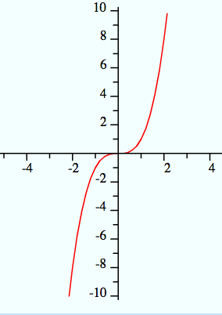
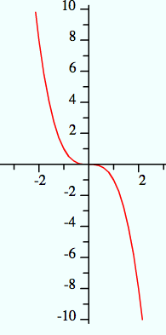
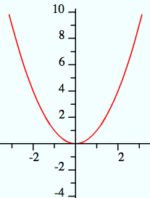
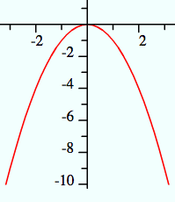
Key Concepts
Ending Behavior – direction of the graph to the far left and to the far right.
 | Even Degree | Odd Degree
Leading Coefficient Positive | Up and Up | Down and Up
Leading Coefficient Negative | Down and Down | Up and Down
Down and Up
Up and Down
Up and Up
Down and Down

Slide 10
Example 3
What is the ending behavior of the graph? Check using graphing calculator.
y = 4x³ – 3x
down and up
y = -2x⁴ +8x³ – 8x² + 2
down and down

Slide 11
Section 5.2 Part 1 Polynomials, Linear Factors, and Zeros
Students will be able to analyze the factored form of a polynomial
Students will be able to write a polynomial function from its zeros

Slide 12
Warm Up
Factor each quadratic expression.
x² + 7x + 12
(x + 3) ( x + 4)
x² + 8x – 20
(x + 10) (x – 2)
x² – 14x + 24
( x – 12) (x – 2)

Slide 13
Example 1
Write 3x³ – 18x² + 24x in factored form.
Factor out GCF, 3x 3x(x² – 6x + 8)
Factor x² – 6x + 8 3x(x – 4)(x – 2)
3x(x – 4)(x – 2)

Slide 14
Key Concepts
The following are equivalent statements about a real number b and a polynomial
x – b is a linear factor of the polynomial P(x)
b is a zero of the polynomial function y = f(x)
b is a root (or solution) of the polynomial equation f(x) = 0
b is an x-intercept of the graph y = f(x)

Slide 15
Key Concepts
Steps to Graphing a Polynomial Function
Use the Zero-Product Property to find the zeros.
Find points between the zeros.
Determine ending behavior.
Use zeros, additional points, and ending behavior to sketch the graph.

Slide 16
Example 2
Find the zeros of y = (x + 1)(x – 1)(x + 3). Then graph the function.
Step 1: Use the Zero-Product Property to find the zeros
(x + 1) = 0 (x – 1) = 0 (x + 3) = 0
x = -1 x = 1 x = -3
Zeros of the function are -3,-1, 1

Slide 17
Example 2 (Continued)
Step 2: Find points on the curve for x-values between zeros.
Evaluate for x = -2, 0
(-2 + 1)(-2 – 1)(-2 + 3) = (-1)(-3)(1) = 3
(0 + 1)(0 – 1)(0 + 3) = (1)(-1)(3) = -3
Step 3: Determine ending behavior
The function is cubic with a leading coefficient of 1, so the ending behavior is down and up

Slide 18
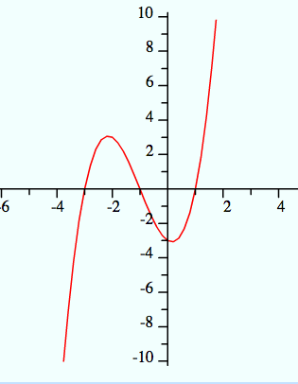
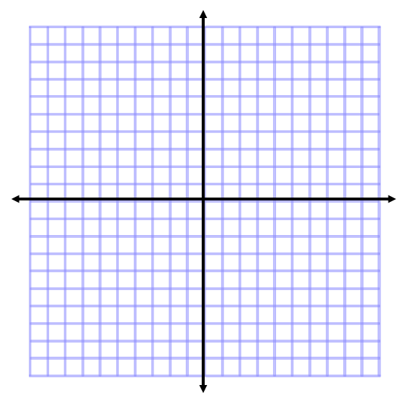
Example2 (Continued)
Step 4: Use zeros, additional points, and ending behavior to sketch the graph

Slide 19
Key Concepts
Factor Theorem
The expression x – a is a factor of a if the value a is a zero of the related polynomial function.

Slide 20
Example 3
Write a polynomial in standard form with zeros at 2, –3, and 0.
Write a linear factor for each zero y = (x – 2)(x + 3)(x – 0)
Simplify (x – 0) = x(x – 2)(x + 3)
Multiply (x – 2)(x + 3) = x(x² + x - 6)
Distribute x = x³ + x² – 6x
y = x³ +x² - 6x

Slide 21
Section 5.2 Part 2 Polynomials, Linear Factors, and Zeros
Students will be able to analyze the factored form of a polynomial
Students will be able to identify relative maximums and minimums

Slide 22
Warm Up
What are the zeros of
f(x) = (x – 2)(x – 2)(x + 1)?
2, 2, -1
2. Suppose someone listed the zeros as 2 and -1. Why might someone think this is a quadratic function?
Answers vary.

Slide 23
Key Concepts
Multiple zero - repeated zero
Multiplicity - the number of times the zero occurs

Slide 24
Example 1
What are the zeros of ƒ(x) = x⁵ – 6x⁴ + 9x³?What are their multiplicities? How does the graph behave at these zeros?
ƒ(x) = x⁵ – 6x⁴ + 9x³
Factor out GCF = x³( x² – 6x + 9)
Factor x² – 6x + 9 = x³(x -3)²
Use the Zero-Product Property x = 0 x – 3 = 0
x = 0 x = 3
Zeros are 0 and 3.
0 has a multiplicity of 3 and 3 has a multiplicity of 2.
The graph looks like a parabola at x = 3 and close to linear at x = 0

Slide 25
Key Concepts
Relative maximum - the greatest y-value of the points in a region of graph
Relative minimum - the least y-value among nearby points on a graph

Slide 26
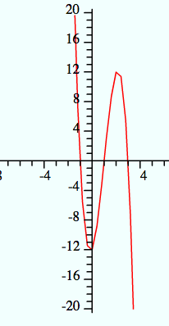
Example 2
What are the relative maximum and minimum of ƒ(x) = -4x³ + 12x² + 4x – 12
Use a graphing calculator
Relative Maximum: (2.15, 12.32)
Relative Minimum: (-0.15, -12.32)

Slide 27
Section 5.3 Part 1 Solving Polynomial Equations
Students will be able to factor polynomial expressions

Slide 28
Warm Up
Factor.
6x² + 12x
6x(x + 2)
8x² + 10x – 3
(4x – 1)(2x + 3)
x² – 81
(x + 9)(x – 9)

Slide 29
Key Concepts
Factoring by Grouping (4 terms)
ax + ay + bx + by = a(x + y) + b(x + y) =
(a + b)(x + y)
Sum of Cubes
a³ + b³ = (a + b)(a² - ab +b²)
Difference of Cubes
a³ – b³ = (a – b)(a² + ab + b²)

Slide 30
Example 1
Factor x³ + 2x² – 3x – 6.
x²(x + 2) -3(x + 2)
(x² – 3)(x + 2)

Slide 31
Example 2
Factor x³ – 8.
(x – 2)(x² + 2x + 4)

Slide 32
Example 3
Factor x³ + 27.
(x + 3)(x² – 3x + 9)

Slide 33
Section 5.3 Part 2 Solving Polynomial Equations
Students will be able to solve polynomial equations by factoring

Slide 34
Warm Up
Factor.
x² + 10x + 25
(x + 5)²
x³ + 2x² – 4x – 8
x²(x + 2) – 4(x + 2) = (x² – 4)(x + 2) = (x + 2)²(x – 2)
x³ - 64
(x – 4)(x² + 4x + 16)

Slide 35
Key Concepts
Steps to solve a polynomial equation by factoring:
Write the equation in the form P(x) = 0
Factor P(x)
Use the Zero-Product Property to find the roots

Slide 36
Example 1
What are the real and imaginary solutions to 2x³ - 5x² = 3x?
Rewrite as P(x) = 0 2x³ - 5x² - 3x = 0
Factor GCF x(2x² - 5x -3) = 0
Factor 2x² - 5x -3 x(2x + 1)(x – 3) = 0
Use Zero-Product Property x = 0 2x + 1 =0 x – 3 =0
x = 0 x = -1/2 x = 3
Solutions are 0, -1/2, 3

Slide 37
Example 2
What are the real and imaginary solutions to x⁴ -3x² = 4?
Rewrite as P(x) = 0 x⁴ – 3x² – 4 = 0
Factor x⁴ -3x² = 4 (x² – 4)(x² + 1) =0
Factor x² – 4 (x + 2)(x – 2)(x² + 1) = 0
Use Zero-Product Property
x + 2 = 0 x – 2 =0 x² + 1 =0
x = -2 x = 2 x = ±i
Solutions are -2, 2, i, -i

Slide 38
Example 3
What are the real and imaginary solutions to x³ = 1?
Rewrite as P(x) = 0 x³ – 1 = 0
Factor x³ – 1 (x – 1)(x² + x + 1) = 0
Use Zero-Product Property
x – 1 =0 x² + x + 1 = 0
x = 1 See Next Slide

Slide 39
Example 3 (Continued)
Use Zero-Product Property
x – 1 =0 x² + x + 1 = 0
x = 1
Solutions are 1,

Slide 40
Section 5.4 Part 1 Dividing Polynomials
Students will be able to divide polynomials using long division

Slide 41
Warm Up
Divide using long division
531 ÷ 3 2. 672 ÷ 21
177 32

Slide 42
Key Concepts
The Divisor Algorithm
You can divide polynomial P(x) by polynomial D(x) to get the quotient Q(x) and a remainder R(x).
If R(x) = 0, then D(x) and Q(x) are factors of P(x).

Slide 43
Key Concepts
Steps to Long Division of Polynomials
Put each polynomial in standard form with zero coefficients where appropriate
Divide, multiply, subtract and repeat until the degree of the remainder is less than the divisor.

Slide 44
Example 1
Divide x² + 2x – 30 by x – 5.
x + 7, R: 5

Slide 45
Example 2
Determine whether x + 2 is a factor of the polynomial x² + 10x + 16.
Yes, x + 2 is a factor of x² + 10x + 16.

Slide 46
Section 5.4 Part 2 Dividing Polynomials
Students will be able to divide polynomials using synthetic division

Slide 47
Warm Up
Evaluate for the given variables.
12

Slide 48
Key Concepts
Synthetic Division – simplifies long division for dividing by a linear expression x – a.
Steps for synthetic division:
Write coefficients (including zeros) of the polynomial in standard form. For the divisor, use the value for x such that x – a = 0 (use a).
Bring down the first coefficient.
Multiply the divisor and add it to the next coefficient.
Continue through the last coefficient.

Slide 49
Example 1
Use synthetic division to divide
5x³ – 6x² + 4x – 1 by x - 3.
Step 1: Write coefficients (including zeros) of the polynomial in standard form. For the divisor, use the value for x such that x – a = 0 (use a).
3 5 -6 4 -1

Slide 50
Example 1 (Continued)
Step 2: Bring down the first coefficient.
3 5 -6 4 -1
5

Slide 51
Example 1 (Continued)
Step 3: Multiply the divisor and add it to the next coefficient.
3 5 -6 4 -1
15
5
9

Slide 52
Example 1 (Continued)
Step 4: Continue through the last coefficient.
3 5 -6 4 -1
15 27 93
5 9 31 92
The quotient is 5x² + 9x + 31, R 92

Slide 53
Key Concepts
Remainder Theorem
If you divide a polynomial P(x) by x – a, then the remainder is P(a).

Slide 54
Example 2
Given that P(x) = x⁵ – 3x⁴ – 28x³ + 5x + 20, what is P(-4)?
-4 1 -3 -28 0 5 20
-4 28 0 0 -20
1 -7 0 0 5 0
P(-4) = 0

Slide 55
Section 5.5 Part 1 Theorems About Roots of Polynomial Equations
Students will be able to solve equations using the Rational Root Theorem

Slide 56
Warm Up
List all the factors of each number.
12
1, 2, 3, 4, 6, 12
2. 24
1, 2, 3, 4, 6, 8, 12, 24
3. 44
1, 2, 4, 11, 22, 44

Slide 57
Key Concepts
Rational Root Theorem
Let be a polynomial with integer coefficients. Then, there are a limited number of possible roots of P(x) = 0:
Integer roots must be factors of a₀.
Rational roots must have reduced form p/q where p is an integer factor of a_{o} and q is an integer factor of a_{n}.

Slide 58
Key Concepts
Steps to Finding Rational Roots:
List the possible rational roots using the Rational Root Theorem.
Test each possible rational root (REMINDER – you could also use synthetic division to evaluate).

Slide 59
Example 1
Find the rational roots of 3x³ – x² – 15x + 5 = 0.
Step 1: List the possible rational roots.
The constant term is 5. The leading coefficient is 3. By the Rational Root Theorem, the only possible rational roots of the equation have the form
Only possible rational roots are ±5, ±5/3, ±1, ±1/3

Slide 60
Example 1 (Continued)
Step 2: Test each possible rational root (REMINDER – you could also use synthetic division to evaluate).
5: 3(5)³ – (5)² – 15(5) + 5 = 280 ≠ 0
-5: 3(-5)³ – (-5)² – 15(-5) + 5= -320 ≠ 0
5/3: 3(5/3)³ – (5/3)² – 15(5/3) + 5 = -8.8 ≠ 0
-5/3: 3(-5/3)³ – (-5/3)² – 15(-5/3) + 5 = -13.3 ≠ 0
1: 3(1)³ – (1)² – 15(1) + 5 = -8 ≠ 0
-1: 3(-1)³ – (-1)² – 15(-1) + 5= 16 ≠ 0
1/3: 3(1/3)³ – (1/3)² – 15(1/3) + 5 = 0 = 0
-1/3: 3(-1/3)³ – (-1/3)² – 15(-1/3) + 5 = 9.7 ≠ 0
The only rational root of 3x³ – x² – 15x + 5 = 0 is 1/3

Slide 61
Example 2
Find the rational roots of 2x³ – x² + 2x + 5 = 0.
Step 1: List the possible rational roots.
The constant term is 5. The leading coefficient is 2. By the Rational Root Theorem, the only possible rational roots of the equation have the form
Only possible rational roots are ±5, ±5/2, ±1, ±1/2

Slide 62
Example 2 (Continued)
Step 2: Test each possible rational root (REMINDER – you could also use synthetic division to evaluate).
5: 2(5)³ – (5)² + 2(5) + 5 = 240 ≠ 0
-5: 2(-5)³ – (-5)² + 2(-5) + 5 = -280 ≠ 0
5/2: 2(5/2)³ – (5/2)² + 2(5/2) + 5 = 35 ≠ 0
-5/2: 2(-5/2)³ – (-5/2)² + 2(-5/2) + 5= -75/2 ≠ 0
1: 2(1)³ – (1)² + 2(1) + 5 = 8 ≠ 0
-1: 2(-1)³ – (-1)² + 2(-1) + 5 = 0 = 0
1/2: 2(1/2)³ – (1/2)² + 2(1/2) + 5 = 6 ≠ 0
-1/2: 2(-1/2)³ – (-1/2)² + 2(-1/2) + 5= 7/2 ≠ 0
The only rational root of 2x³ – x² + 2x + 5 = 0 is -1

Slide 63
Section 5.5 Part 2 Theorems About Roots of Polynomial Equations
Students will be able to use the conjugate root theorem and Decartes’ Rule of Signs

Slide 64
Warm Up
Multiply.
(-4i)(6i)
24
(2 + i)(2 – i)
5
(1 + √3)(1 - √3)
-2

Slide 65
Key Concepts
Conjugate Root Theorem
If P(x) is a polynomial with rational coefficients, then the irrational roots of P(x) occur in pairs. If is an irrational root, then is also a root.
Imaginary Root Theorem
If the imaginary number a + bi is a root of a polynomial equation with real coefficients, then the conjugate a – bi also is a root.

Slide 66
Example 1
A cubic polynomial P(x) has real coefficients. If 2 – 3i and ¾ are two roots of P(x), what is an additional root?
2 + 3i

Slide 67
Example 2
A quartic polynomial P(x) has real coefficients. If and 6 – 2i are two roots of P(x), what are the other two roots?
6 + 2i and -√3

Slide 68
Example 3
Find a third degree polynomial with rational coefficients that has roots –2, and 2 – i.
Write the polynomial in factored form
P(x) = (x + 2)(x - (2 – i))(x – (2 + i))
Multiply the complex conjugates
P(x) = (x + 2)(x² – 4x + 5)
Multiply, simplify, write in standard form
P(x) = x³ – 2x² – 3x + 10

Slide 69
Key Concepts
Decartes’ Rule of Signs
Let P(x) be a polynomial with real coefficients written in standard form.
The number of positive real roots of P(x) = 0 is either equal to the number of sign changes between consecutive coefficients of P(x) or is less than that by an even number.
The number of negative real roots of P(x) = 0 is either equal to the number of sign changes between consecutive coefficients of P(-x) or is less than that by an even number.

Slide 70
Example 4
What does Decartes’ Rule of Signs tell you about the real roots of x³ - x² + 1 = 0?
Identify the number of positive real roots:
P(x) = x³ - x² + 1
Coefficents 1 -1 1
+ to -
Since there are two sign changes, there are either 0 or 2 positive real roots.
- to +
Two sign changes

Slide 71
Example 4 (Continued)
What does Decartes’ Rule of Signs tell you about the real roots of x³ - x² + 1 = 0
Identify the number of negative real roots:
P(-x) = (-x)³ - (-x)² + 1
P(-x) = -x³ – x² + 1
Coefficents -1 -1 1
- to -
Since there is one sign change, there is one negative real root.
- to +
one sign change

Slide 72
Section 5.6 The Fundamental Theorem of Algebra
Students will be able to use the Fundamental Theorem of Algebra to solve polynomial equations with complex solutions

Slide 73
Warm Up
Solve x² + 3x – 7 = 0.

Slide 74
Key Concepts
The Fundamental Theorem of Algebra
If P(x) is a polynomial of degree n ≥ 1, the P(x) = 0 has exactly n roots, including multiple and complex roots.

Slide 75
Key Concepts
Steps to find ALL roots of a polynomial equation.
Put polynomial in standard form and find possible rational roots.
Find a rational root.
Use synthetic division to find another factor.
Repeat until the quotient is factorable or a quadratic.
Solve.

Slide 76
Example 1
Find the roots of 5x³ – 24x² + 41x – 20 = 0.
Step 1: Put polynomial in standard form and find possible rational roots.
The factors of –20 are ±1 and ±20, ±2 and ±10, and ±4 and ±5.
The only factors of 5 are ±1 and ±5.
The only possible rational roots are ±1/5, ±2/5, ±4/5, ±1, ±2, ±4, ±5, ±10, and ±20.

Slide 77
Example 1 (Continued)
Find the roots of 5x³ – 24x² + 41x – 20 = 0.
Step 2: Find a rational root.
P(4/5) = 5(4/5)³ – 24(4/5)² + 41(4/5) – 20 = 0 = 0
Step 3: Use synthetic division to find another factor.
4/5 5 -24 41 -20
4 -16 20
5 -20 25 0
5x³ – 24x² + 41x – 20 = (5x-4)(5x² – 20x + 25)

Slide 78
Example 1 (Continued)
Find the roots of 5x³ – 24x² + 41x – 20 = 0.
Step 4: Repeat until the quotient is a quadratic.
Quotient is 5x² – 20x + 25 which is a quadratic.
Step 5:Solve the quadratic.
The roots are 2 + i, 2 – i, 4/5

Slide 79
Example 2
Find the roots of x⁴ + x³ – 7x² - 9x – 18 = 0.
Step 1: Put polynomial in standard form and find possible rational roots.
The factors of –18 are ±1 and ±18, ±2 and ±9, and ±3 and ±6.
The only factors of 1 are ±1.
The only possible rational roots are ±1, ±2, ±3, ±6, ±9, and ±18.

Slide 80
Example 2 (Continued)
Find the roots of x⁴ + x³ – 7x² - 9x – 18 = 0.
Step 2: Find a rational root.
P(3) =(3)⁴ + (3)³ – 7(3)² – 9(3) – 18 = 0 = 0.
Step 3: Use synthetic division to find another factor.
3 1 1 -7 -9 -18
3 12 15 18
1 4 5 6 0
x⁴ + x³ – 7x² - 9x – 18 = (x-3)(x³ + 4x² + 5x + 6)

Slide 81
Example 2 (Continued)
Find the roots of x⁴ + x³ – 7x² - 9x – 18 = 0.
Step 4: Repeat until the quotient is a quadratic.
P(-3) =(-3)⁴ + (-3)³ – 7(-3)² – 9(-3) – 18 = 0 = 0.
Step 3: Use synthetic division to find another factor.
-3 1 4 5 6
-3 -3 -6
1 1 2 0
x⁴ + x³ – 7x² - 9x – 18 = (x-3)(x + 3)(x² + x + 2)

Slide 82
Example 2 (Continued)
Find the roots of x⁴ + x³ – 7x² - 9x – 18 = 0.
Step 4: Repeat until the quotient is a quadratic.
Quotient is x² + x + 2 which is a quadratic.
Step 5:Solve the quadratic.
The roots are 3, -3, -1/2 + i√7/2, -1/2 - i√7/2

