Slide 1
Chapter 4 Quadratic Functions and Equations
Unit Essential Questions:
What are the advantages of a quadratic function in vertex form?
How is any quadratic function related to the parent quadratic function y = x²?
How are the real solutions of a quadratic equation related to the graph of the related quadratic function?

Slide 2
Lesson 4.1 Quadratic Functions and Transformations
Students will be able to Identify and graph quadratic functions

Slide 3
Warm Up
Evaluate each function for x = -3 and 3.
ƒ (x) = x
f(-3) = -3, f(3) = 3
ƒ (x) = x²
f(-3) = 9, f(3) = 9
ƒ (x) = –x
f(-3) = 3, f(3) = -3
ƒ (x) = –x²
f(-3) = -9, f(3) = -9

Slide 4
Key Concepts
Quadratic Function - a function that can be written in the standard form
f(x)=ax²+bx+c, where a ≠ 0
Parabola - the graph of a quadratic function

Slide 5
Key Concepts
Transformations of y = x²
Vertical Translation (k units) Up: y = x² + k Down: y = x² - k | Horizontal Translation (h units) Right: y = (x - h)² Left: y = (x + h)²
Vertical Stretch/Compression Stretch (a>1): y = ax² Compression (0<a<1): y =ax²--- | Reflection x-axis: -(x²)==== y-axis: (-x)²---

Slide 6
Key Concepts
Vertex form of a quadratic function
y = a ( x – h )² + k
The graph has a vertex (h, k)
The graph has an axis of symmetry at x = h
The graph opens up if a > 0 and opens down if a < 0
The domain is all real numbers.
The range is determined by the vertex and how the graph opens.

Slide 7
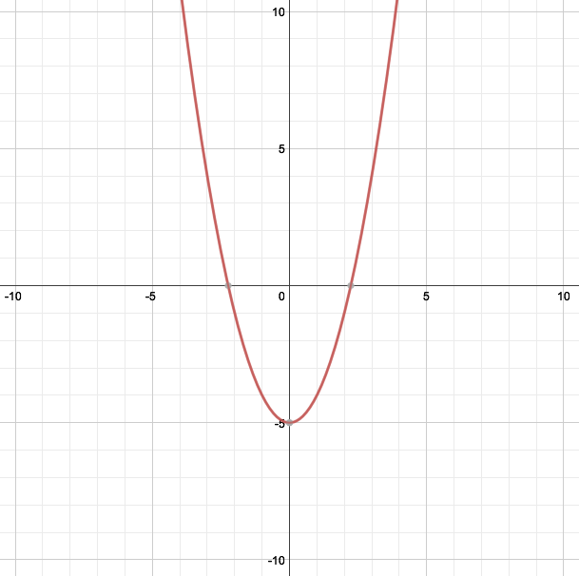
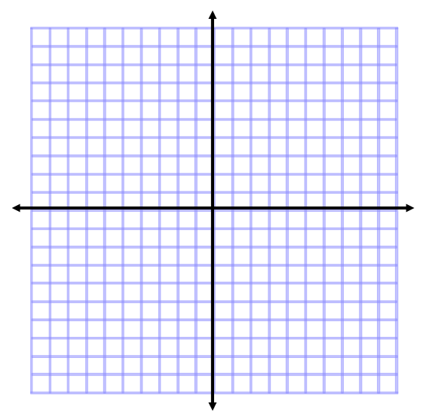
Example 1
Graph the function f(x) = x² – 5. How is the graph a translation of the graph of the parent function f(x) = x²?
The graph shift down 5
units from the parent
function

Slide 8
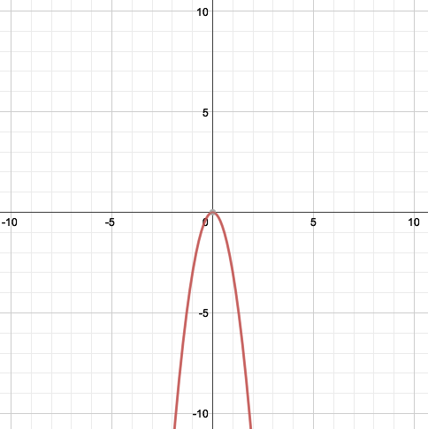
Example 2
Graph the function f(x) = -3x². How is the graph a translation of the graph of the parent function f(x) = x²?
The graph reflects and
stretches by 3 from the
parent function

Slide 9
Example 3
For f(x) = 3(x – 4)² – 2, what are the vertex, the axis of symmetry, the maximum or minimum value, and the domain and the range?
Vertex = (4, -2)
Axis of Symmetry: x = 4
Minimum = -2
Domain: All real numbers
Range: y ≥ -2

Slide 10
Example 4
For f(x) = -2(x + 3)² + 1, what are the vertex, the axis of symmetry, the maximum or minimum value, and the domain and the range?
Vertex = (-3, 1)
Axis of Symmetry: x = -3
Maximum = 1
Domain: All real numbers
Range: y ≤ 1

Slide 11
Lesson 4.2 Part 1 Standard Form of a Quadratic Function
Students will be able to graph quadratic functions written in standard form

Slide 12
Warm Up
Find the slope and y-intercept of the graph of each function.
y = 3x + 3
Slope = 3, y-intercept = (0, 3)
y = –2x – 1
Slope = -2, y-intercept = (0, -1)
3x + 2y = 6
Slope =-3/2, y-intercept = (0, 3)

Slide 13
Key Concepts
Steps to Graph Quadratic Equations in Standard Form:
Put the equation in standard form:
y = ax² + bx + c
2. Extract the values for a, b, and c.
3. Find the axis of symmetry: x = -b/2a
Find your vertex: substitute your “axis of symmetry” x value back into the original equation and solve for y.
Construct a table of more values for x and y. (Choose values for x to the left and right of your vertex “x” value. Substitute x-values into original equation to find y-values.)
Plot the points and connect them with a U-shaped curve.

Slide 14
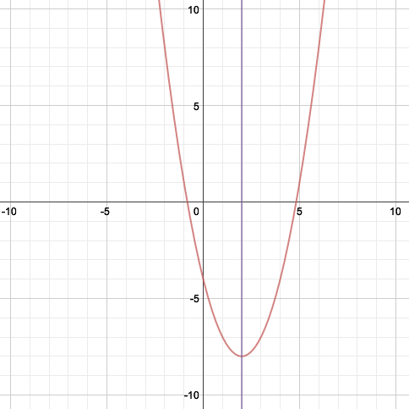
Example 1
Graph x² – 4x - 4 using a table of values.
Find the axis of symmetry, vertex, and the maximum or minimum value. (Use a dotted line to graph the axis of symmetry)
x | y
0 | -4
1 | -7
2 | -8
3 | -7
4 | -4
Vertex = (2, -8)
Axis of Symmetry: x = 2
Minimum = -8

Slide 15
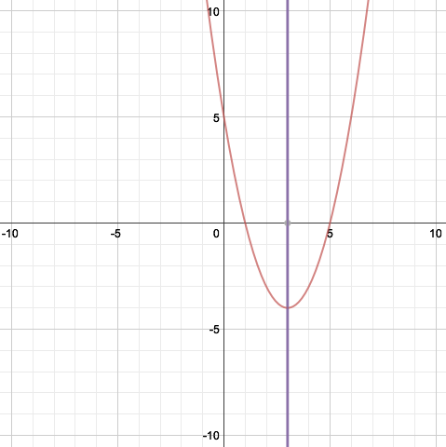
Example 2
Graph x² – 6x + 5 using a table of values.
Find the axis of symmetry, vertex, and the maximum or minimum value. (Use a dotted line to graph the axis of symmetry)
x | y
1 | 0
2 | -3
3 | -4
4 | -3
5 | 0
Vertex = (3, -4)
Axis of Symmetry: x = 3
Minimum = -4

Slide 16
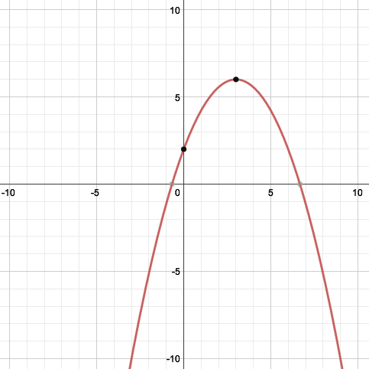
Example 3
Sketch the parabola using the given information: vertex(3, 6) and the point (0,2) on the graph

Slide 17
Lesson 4.2 Part 2 Standard Form of a Quadratic Function
Students will be able to write quadratic functions in standard form

Slide 18
Warm Up
Find the vertex of the graph of each function.
y = | x |+ 5 2. y = | x + 7 |- 3
(0, 5) (-7, -3)

Slide 19
Key Concepts
Vertex form of a quadratic function:
y = a ( x – h )² + k
Steps to Graph Quadratic Equations in Vertex Form:
Identify “a” and “b” from the standard form of the equation.
Find the vertex by using: x=-b/2a, then plug it in to find: y=f(-b/2a).
Write the equation in vertex form by replacing “h” with x=-b/2a and “k” with y = f(-b/2a). Finally insert “a” from the standard form as “a” in the vertex form--as they are the same value in both

Slide 20
Example 1
Write y = –x² + 4x – 5 in vertex form.
Identify the
x-coordinate
of the vertex:
Vertex = (2, -1)
Identify the
y-coordinate
of the vertex:
Write in vertex form:

Slide 21
Example 2
Write y = 2x² + 12x + 7 in vertex form.
Identify the
x-coordinate
of the vertex:
Vertex = (-3, -11)
Identify the
y-coordinate
of the vertex:
Write in vertex form:

Slide 22
Lesson 4.4 Part 1 Factoring Quadratic Expressions
Students will be able to factor using greatest common factor

Slide 23
Warm Up
Multiply
3(x – 2)
3x – 6
x(x - 9)
x² – 9x
(x + 5)(x – 9)
x² - 4x – 45
x²(x² - 4x + 5)
x⁴ - 4x³ + 5x²

Slide 24
Key Concepts
Factoring - rewriting an expression as the product of its factors. (un-distributing)
Greatest Common Factor (GCF) – the largest quantity that is a factor of all the integers or polynomials involved.

Slide 25
Example 1
Find the GCF of each list of numbers.
a. 12 and 8
12 = 2 · 2 · 3
8 = 2 · 2 · 2
So the GCF is 2 · 2 = 4.
b. 7 and 20
7 = 1 · 7
20 = 2 · 2 · 5
There are no common prime factors so the GCF is 1.

Slide 26
Example 2
Find the GCF of each list of terms.
a. x³ and x⁷
x³ = x · x · x
x⁷ = x · x · x · x · x · x · x
So the GCF is x · x · x = x³
b. 6x⁵ and 4x³
6x⁵ = 2 · 3 · x · x · x
4x³ = 2 · 2 · x · x · x
So the GCF is 2 · x · x · x = 2x³

Slide 27
Example 3
Factor.
a. 15x² + 100 b. 8m² + 4m c. 3x² + 6x
5(3x² – 20)
4m(2m + 1)
3x(x + 2)

Slide 28
Example 4
Factor out the GCF in each of the following polynomials.
a. 6x³ – 9x² + 12x
= 3x · 2x² – 3x · 3x + 3x · 4
= 3x(2x² – 3x + 4)
b. 14x³y + 7x²y – 7xy
= 7xy · 2x² + 7xy · x – 7xy · 1
= 7xy(2x² + x – 1)

Slide 29
Example 5
Factor out the GCF in each of the following polynomials.
6(x + 2) – y(x + 2)
= (x + 2)(6 – y)
xy(y + 1) – (y + 1) =
= (y + 1)(xy – 1)

Slide 30
Lesson 4.4 Part 2 Factoring Quadratic Expressions
Students will be able to factor using grouping

Slide 31
Warm Up
Factor out the GCF.
x(x + 2) – 3(x + 2)
(x – 3)(x + 2)
x²(x – 1) + (x – 1)
(x² + 1)(x – 1)
4x(y + 12) + (y + 12)
(4x + 1)(y + 12)

Slide 32
Key Concepts
Factor by Grouping – factor a polynomial by grouping the terms of the polynomial and looking for common factors.
Factoring by Grouping (4 terms)
ax + ay + bx + by = a(x + y) + b(x + y) =
(a + b)(x + y)

Slide 33
Example 1
Factor x³ + 2x² – 3x – 6.
x²(x + 2) -3(x + 2)
(x² – 3)(x + 2)

Slide 34
Example 2
Factor x³ + 4x + x² + 4.
x³ + 4x + x² + 4 = (x³ + 4x) + (x² + 4)
= x(x² + 4) + 1(x² + 4)
= (x² + 4)(x + 1)

Slide 35
Example 3
Factor 2x³ – x² – 10x + 5.
2x³ – x² – 10x + 5 = (2x³ – x²) – (10x + 5)
= x²(2x – 1) – 5(2x – 1)
= (2x – 1)(x² – 5)

Slide 36
Lesson 4.4 Part 3 Factoring Quadratic Expressions
Students will be able to factor a trinomial with leading coefficient = 1

Slide 37
Warm Up
Multiply.
(x + 2)(x – 5)
x² - 3x – 10
(y – 7)(x – 1)
xy - y - 7x + 7
(x + y)(2x – y)
2x² + xy – y²

Slide 38
Key Concepts
Factoring Trinomials with Leading Coefficient = 1:
Factor a GCF if possible
Find two numbers that multiply to the last term and add to the middle term.
FOIL to check

Slide 39
Example 1
Factor:
a) x² + 10x + 24
(x + 6)(x + 4)
b) x² – 4x – 12
(x - 6)(x + 2)
c) x² – 14x + 33
(x - 11)(x - 3)

Slide 40
Example 2
Factor.
a) 2x² + 6x –56.
2(x + 7)(x – 4)
b) -t² + 6t – 5
- (t - 5)(t - 1)

Slide 41
Lesson 4.4 Part 4 Factoring Quadratic Expressions
Students will be able to factor a trinomial with leading coefficient ≠ 1

Slide 42
Warm Up
Write 2 different expressions that have a factor of (x + 6).
Answers Vary
Examples: x² + 6x and x² + 5x – 6

Slide 43
Key Concepts
Steps for Factoring with a Leading Coefficient ≠ 1:
Find factors that add to b and multiply to ac.
Split the “b” term with the two values your found in step 1.
Factor by grouping.
ac
b

Slide 44
Example 1
Factor:
5x² - 13x + 6
Find two values
that multiply to
30 and add to -13.
30
-10
-3
-13
Split “b” with
the values.
5x² – 10x – 3x + 6
5x(x – 2) – 3(x – 2)
Factor by
grouping
(5x – 3)(x – 2)

Slide 45
Example 2
Factor:
2x² + 9x – 5
Find two values
that multiply to
-10 and add to 9.
-10
10
-1
9
Split “b” with
the values.
2x² + 10x - x – 5
2x(x + 5) – 1(x + 5)
Factor by
grouping
(2x – 1)(x + 5)

Slide 46
Example 3
Factor:
5x² + 28x + 32
Find two values
that multiply to
160 and add to 28.
160
20
8
28
Split “b” with
the values.
5x² + 20x + 8x + 32
5x(x + 4) + 8(x + 4)
Factor by
grouping
(5x + 8)(x + 4)

Slide 47
Lesson 4.4 Part 5 Factoring Quadratic Expressions
Students will be able to factor special quadratic expressions

Slide 48
Warm Up
Multiply
(2x – 7)(2x – 7)
4x² - 28x +49
(4x + 3)(4x – 3)
16x² - 9

Slide 49
Key Concepts
Special Cases
Perfect Square Trinomial
a² + 2ab + b² = (a + b)(a + b) = (a + b)²
Or
a² - 2ab + b² = (a – b)(a – b) = (a - b)²
Difference of Two Square
a² – b² = (a + b)(a – b)

Slide 50
Example 1
Factor x² + 10x + 25
(x + 5)²

Slide 51
Example 2
Factor x² - 18x + 81
(x - 9)²

Slide 52
Example 3
Factor x² – 16
(x + 4)(x – 4)

Slide 53
Example 4
Factor 25x² – 121
(5x + 11)(5x – 11)

Slide 54
Lesson 4.5 Quadratic Equations
Students will be able to solve a quadratic equation by factoring

Slide 55
Warm Up
Factor.
x² + 5x – 14
(x + 7)(x – 2)
2. 4x² – 12x
4x(x – 3)
3. 9x² – 16
(3x – 4)(3x + 4)

Slide 56
Key Concepts
Standard form of a quadratic equation
ax² + bx + c = 0
Zero-Product Property
If ab=0, then a=0 or b=0.
Zero of a function - a solution of a quadratic equation. The x-intercepts of the parabola

Slide 57
Example 1
Solve by factoring x² – 5x + 6 = 0
Factor the Trinomial
Set each factor
equal to zero
Solve

Slide 58
Example 2
Solve by factoring 3x² – 20x – 7 = 0
Factor the Trinomial
Set each factor
equal to zero
Solve

Slide 59
Example 3
Solve by factoring x² – 18 = 3x
Put in standard form
Factor the Trinomial
Set each factor
equal to zero
Solve

Slide 60
Section 4.6 Part 1 Completing the Square
Students will be able to solve perfect square trinomial equations

Slide 61
Warm Up
Simplify:
(2x – 1)(2x – 1)
4x² - 4x + 1
(x + 4)(x + 4) – 3
x² + 8x + 13

Slide 62
Example 1
Solve by finding the square roots.
a. 3x² - 5 = 7 b. 4x² + 10 = 46
Add 5:
Subtract 10:
Divide 3:
Divide 4:
Square root:
Square root:

Slide 63
Key Concepts
REMINDER FROM SECTION 4.4 ON FACTORING:
Perfect square trinomial - the product you obtain when you square a binomial.
Ex. (a+b)² = a²+2ab+b² ; or (x+8)² = x²+2(8x)+8² = x²+16x+64
Ex. (a-b)² = a²-2ab+b² ; or (y-5)² = y²-2(5y)+5² = y²-10y+25

Slide 64
Example 2
What are the solutions to x² + 4x + 4 = 25?
Factor
Square root
Subtract 2

Slide 65
Example 3
What are to solutions of x² – 14x + 49 = 81?
Factor
Square root
Add 7

Slide 66
Section 4.6 Part 2 Completing the Square
Students will be able to solve equations by completing the square

Slide 67
Warm Up
Solve:
2x² = 72
x = ± 6
6x² = 54
x = ± 3

Slide 68
Key Concepts
Completing the square - the process of finding the last term of a perfect square trinomial.
x² + bx + (b/2)² = (x + (b/2))²

Slide 69
Example 1
Find the missing value to complete the square:
a. x² + 20x
100
x² + 18x
81

Slide 70
Key Concepts
Step to solving by completing the square:
Make sure leading coefficient = 1.
Isolate the terms with the variable
Add (b/2)² to both sides
Factor the perfect square trinomial
Solve

Slide 71
Example 2
Solve x² + 6x - 12 = 0.
Add 12
x² + 6x = 12
Add (b/2)²
(6/2)² = 9
x² + 6x + 9 = 21
Factor
(x + 3)² = 21
Solve

Slide 72
Example 3
Solve 2x² + 8x – 2 = 0.
Divide 2
x² + 4x – 1 = 0
Add 1
x² + 4x = 1
Add (b/2)²
(4/2)² = 4
x² + 4x + 4 = 5
Factor
(x + 2)² = 5
Solve

Slide 73
Section 4.7 The Quadratic Formula
Students will be able to solve quadratic equations using the quadratic formula.

Slide 74
Warm Up
Write each quadratic in standard form.
y = 8 – 10x² 2. y = (x + 2)² – 1

Slide 75
Key Concepts
The Quadratic Formula

Slide 76
Example 1
Use the Quadratic Formula to solve
3x² + 23x + 40 = 0.
a = 3
b = 23
c = 40

Slide 77
Example 2
Solve 3x² + 2x = 4
Add 4
a = 3
b = 2
c = -4

Slide 78
Section 4.8 Part 1 Complex Numbers
Students will be able to perform operations with complex numbers

Slide 79
Warm Up
Simplify.

Slide 80
Key Concepts
i - the imaginary number that is defined as the number whose square is -1.
i² = -1

Slide 81
Example 1
Simplify.

Slide 82
Example 2
Simplify (3 + 6i) – (4 – 8i).
(3 – 4) + (6 + 8)i
-1 + 14i

Slide 83
Example 3
Find each product.
(3i)(8i)
24i² = 24(-1) = -24
b) (3 – 7i )(2 – 4i )
6 – 12i - 14i + 28i² = 6 – 26i -28
= -22 – 26i

Slide 84
Section 4.8 Part 2 Complex Numbers
Students will be able to find complex number solutions of quadratic equations

Slide 85
Warm Up
Solve 2x² – 32 = 0

Slide 86
Example 1
Solve 9x² + 54 = 0.
Subtract 54
Divide 9
Square Root
Simplify

Slide 87
Example 2
Solve x² + 5 = 4x.
Put in Standard form
Put into
Quadratic Formula
Simplify

