Slide 1
Chapter 3 Linear Systems
Unit Essential Questions:
How does representing functions graphically help you solve a system of equations?
How does writing equivalent equations help you solve a system of equations?

Slide 2
Section 3.1 Solving Systems Using Tables and Graphs
Students will be able to solve linear systems using a graph

Slide 3
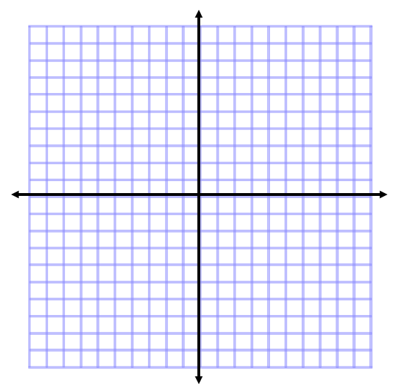
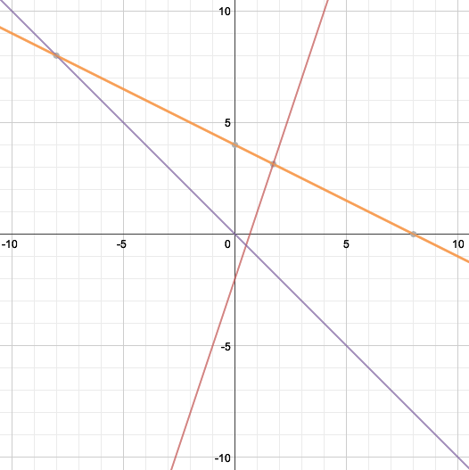
Warm Up
Graph each equation. Use one coordinate plane for all 3 graphs.

Slide 4
Key Concepts
Systems of Equations- a set of two or more equations that use the same variables.
Linear System- when the graph of each
equation of a system is a line.
Solution of a System – a set of values for the variables that makes all the equations true.

Slide 5
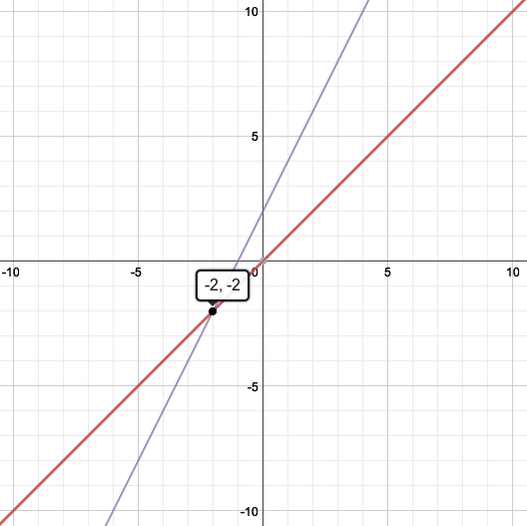
Example 1
Solve the system graphing.
Graph each line. The point of
intersection is the solution
to the system.

Slide 6
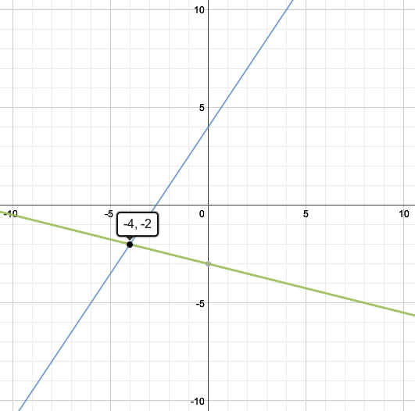
Example 2
Solve the system by graphing.
Graph each line. The point of
intersection is the solution
to the system.

Slide 7
Key Concepts
Independent system- a system that has a unique solution. (Not every system has one)
Intersecting lines
Different Slopes
Dependent system- a system that does not have a unique solution.
Coinciding lines
Same Slope & Same Y-Intercept
Inconsistent system- a system with no solution.
Parallel lines
Same Slope but Different Y-Intercepts

Slide 8
Example 3
Classify the system without graphing.
Rewrite each equation
in slope intercept form.
Add 6x.
Divide by 2.
Equations are the same.
Dependent

Slide 9
Example 4
Classify the system without graphing.
Rewrite each equation
in slope-intercept form.
Add 2x.
Divide by 8.
Divide by 4.
Slopes are the same
but y-intercepts are different.
Inconsistent

Slide 10
Section 3.2 Part 1 Solving Systems Algebraically
Students will be able to solve linear systems using substitution

Slide 11
Warm Up
Evaluate for a = 2 and b = -6
2(7a – b)
2(7(2)-(-6)) = 40
a + b
2 + (-6) = -4
b²
(-6)² = 36

Slide 12
Key Concepts
Substitution – means to plug in or replace a
variable with an expression.
Steps for Solving Systems using Substitution:
Solve for one variable in one equation
Substitute that variable into the other equation.
Solve for a variable
Substitute the answer to solve for the other variable

Slide 13
Example 1
Solve the system by substitution.
Step 1: Solve for a variable.
Step 2: Substitute into
the other equation
Step 3: Solve
Step 4: Substitute the
variable and solve for
the other variable

Slide 14
Example 2
Solve the system by substitution.
Step 1: Solve for a variable.
Step 2: Substitute into
the other equation
Step 3: Solve
Step 4: Substitute the
variable and solve for
the other variable

Slide 15
Section 3.2 Part 2 Solving Systems Algebraically
Students will be able to solve linear systems using elimination

Slide 16
Warm Up
Find the additive inverse of each term.
4 2. –x
-4 x
3. 5x 4. 8y
-5x -8y

Slide 17
Key Concepts
Elimination - using the Addition Property of Equality, or use additive inverses to cancel a variable.
Steps for Solving Systems using Elimination:
Put each equation in standard form
Modify (if needed) one or both equations so that a variable will be eliminated
Add equations
Solve for a variable
Substitute the variable back into an equation to solve for the other variable

Slide 18
Example 1
Use the elimination method to solve the system.
Steps 1&2: Skip (3x and
-3x are additive inverses).
Step 3: Add equations
Step 4: Solve
Step 5: Substitute the
variable and solve for
the other variable

Slide 19
Example 2
Use the elimination method to solve the system.
Step 1: Skip (Already in
Standard Form.
Step 2: Multiply first
equation by 3 and second
equation by -2
Step 3: Add equations
Step 4: Solve
Step 5: Substitute the
variable and solve for
the other variable

Slide 20
Example 3
Use the elimination method to solve the system.
Step 1: Skip (Already in
Standard Form.
Step 2: Multiply first
equation by 2
Step 3: Add equations
Step 4: Solve

Slide 21
Section 3.3 Systems of Inequalities
Students will be able to solve systems of linear inequalities

Slide 22
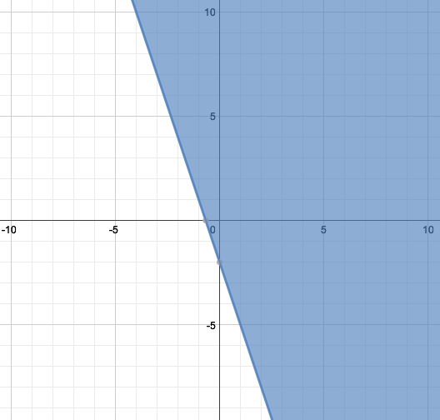
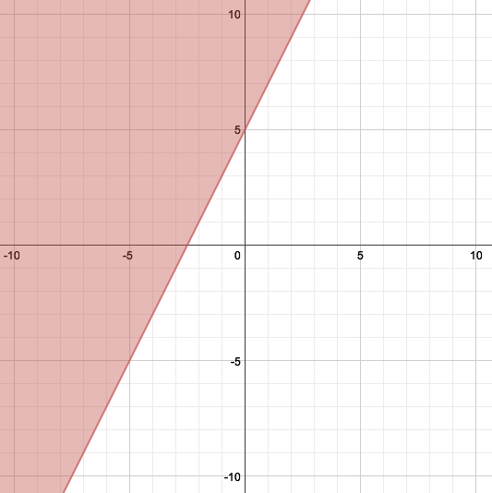
Warm Up
Graph each Inequality.

Slide 23
Key Concepts
You can solve a system of linear inequalities by graphing.
Steps to Solving Systems of Inequalities by Graphing:
First graph boundary lines and decide whether the boundary lines are included.
Then decide which side of the boundary lines to shade.
If < or >, boundary not included; use dashed line.
If ≤ or ≥, boundary included; use solid line.
The solutions are any point where the shaded regions overlap.

Slide 24
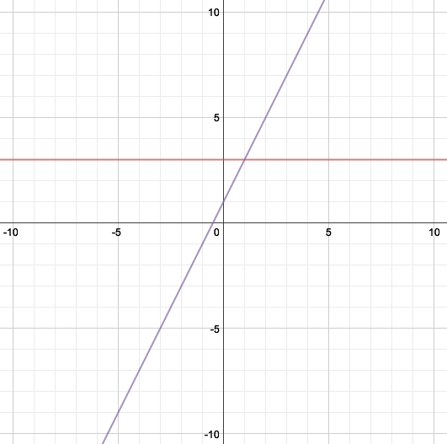
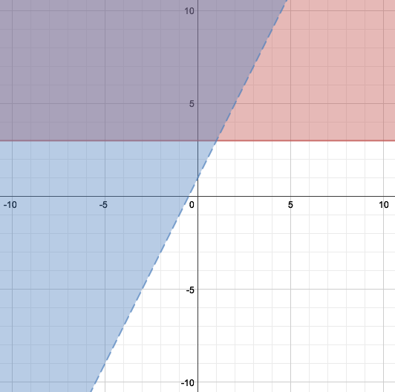
Example 1
Solve the system of inequalities by graphing.
Step 1: Graph y = 3 (boundary line
included) and y = 2x + 1
(boundary line not included).
Step 2: Shade
Step 3: Overlapping area
are the solutions

Slide 25
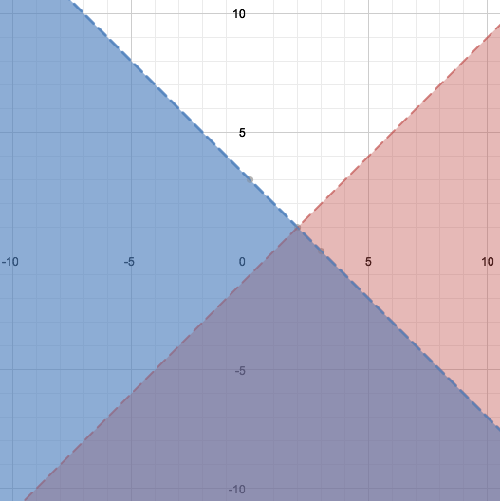
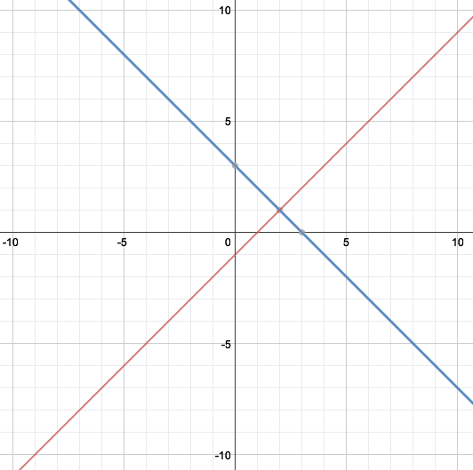
Example 2
Solve the system of inequalities by graphing.
Step 1: Graph –x + y = -1
(boundary line not included) and
x + y = 3 (boundary line not
included).
Step 2: Shade
Step 3: Overlapping area
are the solutions

Slide 26
Section 3.5 Systems With Three Variables
Students will be able to solve systems in three variables

Slide 27
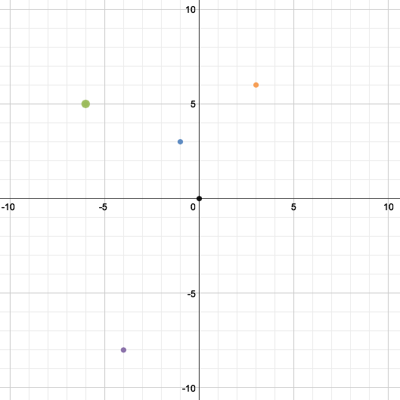
Warm Up
Graph each ordered pair on the coordinate plane.
(–4, –8)
(3, 6)
(0, 0)
(–1, 3)
(–6, 5)

Slide 28
Key Concepts
Steps for Solving Systems with Three Variables
1. Write each equation in standard form.
2. Choose a PAIR of equations and eliminate one of the variables.
3. Choose a different pair of equations and eliminate the SAME variable.
4. Once steps 2 and 3 are complete, then use substitution or elimination method to solve for one variable.
5. Substitute the value you found in step 4 into one of the equations from step 4 and solve for the other variable.
6. Then substitute the two answers you found into the one of the original equations and solve for the remaining variable.
7. Put answer into ordered triple. (x, y, z).

Slide 29
Example 1
Solve the system.
Step 1: Skip (Already in standard form).
Step 2: Pick 2 equations and eliminate
1 variable
Step 3: Pick 2 different equations
and eliminate the same variable

Slide 30
Example 1 (Continued)
Step 4: Solve for 1
variable (use elimination)
Step 5: Solve for another
variable
Step 6: Solve for another
variable

Slide 31
Example 2
Solve the system.
Step 1: Skip (Already in standard form).
Step 2: Pick 2 equations and eliminate
1 variable
Step 3: Pick 2 different equations
and eliminate the same variable

Slide 32
Example 2 (Continued)
Step 4: Solve for 1
variable (use elimination)
Step 5: Solve for another
variable
Step 6: Solve for another
variable

