Slide 1
Bell Work
Problem 1) Predict the next three numbers.
(a) 17, 15, 12, 8,….
(b) 64, 16, 4, 1, ¼ ,….
(c) 48, 16, 16/3, 16/9, ….
(d) 4, -6, 8, -10, …
Problem 2) Pick a secret number. Add 5. Multiply by 2. Subtract 4. Divide by 2. Subtract your secret number. What is your conjecture (conclusion)?

Slide 2
Outcomes
I will be able to:
1) Define the “Building Blocks” of geometry
2) Represent the building blocks with symbols

Slide 3
Defining Terms
A definition uses known words to describe a new word. In geometry, some words, such as point, line, and plane, are undefined terms.
Although these words are not formally defined, it is important to have general agreement about what each word means.

Slide 4
Building Blocks of Geometry
There are 3 building blocks of geometry
They are undefined terms, but we can form generalizations about each of them.
1) Point – Has no dimension and is usually represented by a dot.
2) Line – Extends in one dimension and is usually represented by a straight line with arrows indicating it extends to infinity in both directions.
3) Plane – Extends in two dimensions and is usually represented by a flat two dimensional surface. It also extends to infinity from all edges.

Slide 5
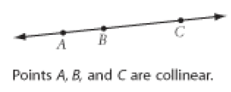
Building Blocks of Geometry
Collinear Points –
Points that lie on the same line.
Coplanar Points –
Points that lie on the same plane

Slide 6
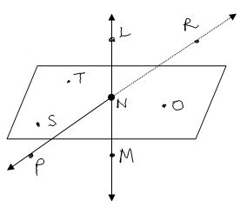
Example 1
Example:
1. Use the diagram on the right to answer the following questions:
(a) Name four points that are coplanar.
(b) Name four points that are not coplanar.
(c) Name three points that are collinear.
(d) Are L, N, O, and P coplanar? Why or why not?

Slide 7
Geometric Objects From the Building Blocks
Line Segment – All points between two endpoints
End Points – Specific starting and stopping points
Ray – All points that lie on one side of an initial point
Initial Point – The starting point of a ray
Opposite Rays – Rays that have the same initial point

Slide 8
Examples
1. Draw three noncollinear points A, B, and C. Draw a point D that is collinear with A and B.

Slide 9
Examples

Slide 10
Finding Representations
With a partner, come up with some type of visual representation in this classroom for each type of geometric figure we just discussed
Collinear points, coplanar points, end points, line segment, and ray
Be prepared to share and explain with the class

Slide 11
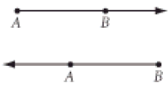
Geometric Symbols
Make sure you have a symbolic representation of each geometric object in your notes
Point: represented by: P
Line represented by: AB, BC, AC
Line Segment represented by AC or AC
Ray represented by: AB represented by: BA

Slide 12
Intersections
Intersect – Two Geometric figures with one or more points in common
Intersection – The set of points two figures that intersect have in common

Slide 13
Examples
1. Draw a line and a plane that do not intersect.

Slide 14
Examples
2. Draw two planes that do not intersect and a line that intersects each plane in one point.

Slide 15
“Modeling Intersections” page 12
With a partner, Take 2 index cards and label them plane M and N.
Follow directions found on Page 12
What is the intersection of lines AB and CD?
What is the intersection of lines AB and EF?
Cont.

Slide 16
Modeling Intersections
Put your two index cards together and look for intersections
What is the intersection of planes M and N?
Are lines CD and EF coplanar?

Slide 17
Exit Quiz
1) Sketch points A, B, C so that they are coplanar and point D so that it is not
2) Sketch points A, B, C so that they are collinear and point D so that it is not
3) Sketch Ray BA
4) Sketch Ray BA and Ray BC, so they are opposite rays

